Slide 1
A Focus on Goal Achievement:
An Emerging Framework for Employment and Related Human Service Programs
LaDonna Pavetti, Ph.D.
Center on Budget and Policy Priorities
July 22, 2015

Slide 2
Why Create a New Framework for Employment and Related Human Service Programs?
History: Modest success, even in the most effective programs
The future: Need to invest in adults to see big improvements in long-term outcomes for kids
Changing labor markets: Declining employment among single mothers with high school education or less for most of the last 10 years; high unemployment rates for young adults, especially African Americans and Hispanics, increased demand for skills
New possibilities: Evidence that if we teach “life skills” we can do better

Slide 3
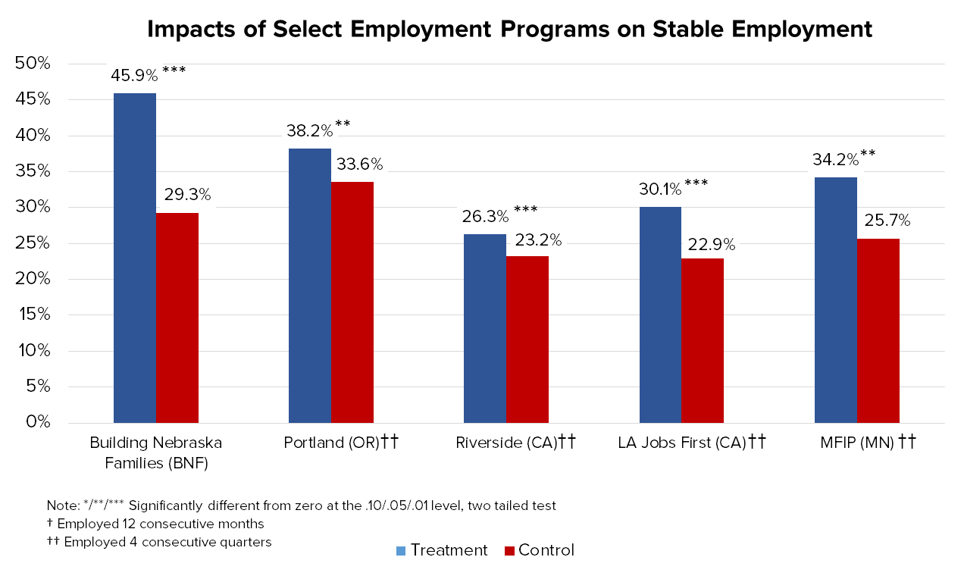
Existing programs make a significant difference for some, but many program participants are left behind

Slide 4
Why Focus on Goal Achievement?
Grounded in science
Compatible with key program purposes, but provides a new approach to service delivery
Provides a framework that can guide individual, organization and community goals simultaneously
Shifts the emphasis from what we do to what we achieve and how we achieve it
Creates a structure for measuring interim progress toward longer-term goals – especially useful for individuals with significant employment barriers
Makes explicit how critical “life management” or “executive function” skills are to success at school, home and work

Slide 5
The Science Behind Goal Achievement Comes from Research on Self-Regulation and Executive Function
Self-regulation is the ability to control one’s behavior, emotion and thoughts
Executive functions are a set of processes or skills that all have to do with managing oneself and one's resources in order to achieve a goal
An umbrella term for skills we use to:
Organize and plan
Control how we react to situations
Get things done

Slide 6
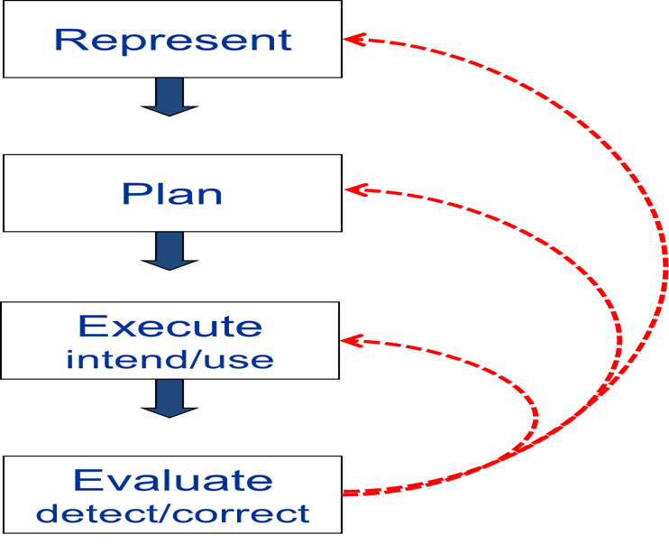
The Goal Achievement/Problem Solving Process Is an Iterative Process that Relies on Executive Function Skills and Self-Regulation
Set
Plan
Act
Review/
Revise
Goal Achievement/Problem-Solving Process:
Phil Zelazo, Executive Function expert, University of Minnesota

Slide 7
What are executive function skills? (adapted from the work of Peg Dawson and Richard Guare)
Skills we use to organize and plan things
Organization
Time Management
Planning/Prioritization
Skills we use to control how we react to situations
Response Inhibition
Flexibility
Emotional Control
Metacognition
Skills we use to get things done
Task Initiation
Sustained Attention
Goal-Directed Persistence
Stress Tolerance
Working Memory

Slide 8
Executive Function and Self-Regulation Skills Are Important to Work and Related Human Programs Because They Play a Critical Role in Successful Goal Achievement
Goal-Achievement Process | Executive Functioning Skills
Set | Metacognition, working memory
Plan | Planning/prioritization, time management, working memory, task initiation
Act | Task initiation, response inhibition, time management, sustained attention, working memory
Review/Revise | Metacognition, flexibility, working memory

Slide 9
Factors Related to Living in Poverty that Influence Executive Function Skills
Toxic Stress
Bandwidth Tax (Living in conditions of chronic scarcity)
Environmental and “life” factors

Slide 10
What is toxic stress and why does it matter?
Toxic stress is prolonged activation of stress response systems in the absence of protective relationships.
Toxic stress disrupts brain architecture and impairs the development of executive functions.
If children do not get what they need from their relationships with adults and the conditions in their environments—or (worse) if those influences are sources of toxic stress—their skill development can be seriously delayed or impaired.
Exposure to toxic stress has lifelong consequences

Slide 11
What is the “bandwidth tax” and what does it have to do with living in poverty?
Living in poverty means living in chronic scarcity
Living under the conditions of scarcity imposes a “bandwidth tax” which reduces the cognitive resources that individuals have available to devote to activities aimed at achieving long-term goals
Researchers that have studied scarcity liken living in poverty to living perpetually on a missed night of sleep
The impact of the bandwidth tax:
Reduces capacity to think logically and analyze and solve novel problems and process information
Diminishes ability to evaluate options and make high-quality decisions
Impairs self-control, often leading to impulsivity

Slide 12
Environmental and “life” factors that negatively impact executive functions
Stress
Poor nutrition
Lack of sleep
Lack of social connections (loneliness)
Sadness
Physically unfit

Slide 13
Implications for Work and Related Human Service Programs: Executive Function-Informed Practice Is Focused on Changing How We Provide Services
Policy/Community Context
Human Service Programs
Frontline Staff
Executive Function-informed
Clients

Slide 14
What Makes an EF-Informed Goal-Setting Process Different from Current Practice at the Frontline?
Assessment with a purpose – what is going to get in the way of success?
More explicit emphasis on goal setting and achievement – how goals are set matters
More intentional and specific approach to planning – break goals down into manageable steps with explicit plans for achieving them (down to the day and time something will get done)
“Living” plans that are regularly reviewed and revised
Different approach to providing support – creating “scaffolds” that break tasks into small steps; provide as much support as is needed to successfully complete the task
Important role for using incentives to engage participants and build skills
Focus on active skill building that involves modeling use of skills and practice in settings that mimic the settings where they will be used

Slide 15
An Example of a Goal-Achievement Model
Knowledge of strengths & limitations
Knowledge of resources & opportunities
Motivation & passion
Coaching
Informed Goal-Setting
Planning
Incentives
Action
Review & Refine

Slide 16
Implications for Program Design
Greater attention to defining and understanding the progressive steps for achieving long- and short-term goals.
More explicit attention to program’s mission, goals, and services – what role can an individual or set of coordinated programs do to support individuals in achieving their goals? How far can you take an individual given your mission and resources?
Greater attention to how a program will work with an individual to achieve their goals: Who will work with an individual to facilitate goal achievement (e.g., coach/direct service staff, peers, online)? Where will it occur (e.g., in an individual’s home, in the office, individual meetings, dyads/triads, groups)? What is the process of engagement and support?
Greater attention to changes that can create a more streamlined and supportive program, work, and home environment. (Interventions to reduce the strain on executive skills)
Identification of resources and processes can be used to motivate and reward goal achievement? (Use of incentives to encourage program participation and completion)
Explicit attention to documenting and measuring success (and failure). How are progress and performance outcomes used to instill accountability, implement course corrections, and celebrate successes?

Slide 17
Program examples

Slide 18
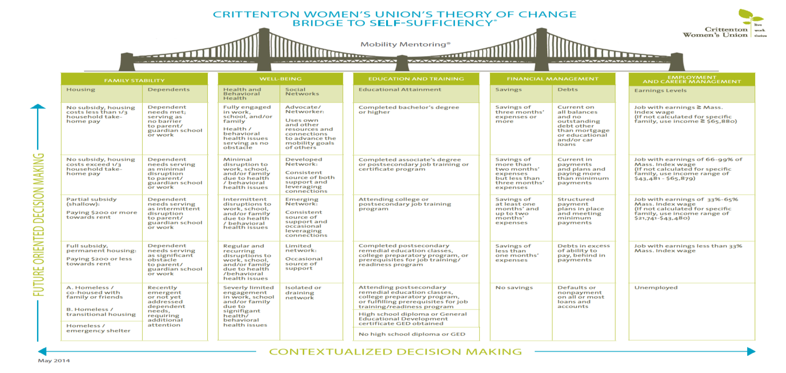
Example: Crittenton Women’s Union
Notes:
Major contribution to the field is the bridge model
Believe a person has to be stable in all these aspects of life in order to maintain self-sufficiency
Everything they do is based around the bridge: assessment, goal development, and client progress

Slide 19
Example: New Haven MOMS Partnership
Cognitive behavioral therapy intervention (within the context of stress reduction) for mothers in public housing developments
Extensive use of incentives (e.g., Walmart gift cards; personal care items)
Community collaborative – public/private partnership
Neighborhood hubs, including one in a grocery store
Hired “community ambassadors” to deliver services – act as a critical bridge between the community and agency staff
Innovative use of technology – Momba cellphone app
Adding a workforce component
Accomplishments:
Extremely high levels of participation and completion
Significant reduction in parental stress
Significant reduction in depression
Significant increase in social connections

Slide 20
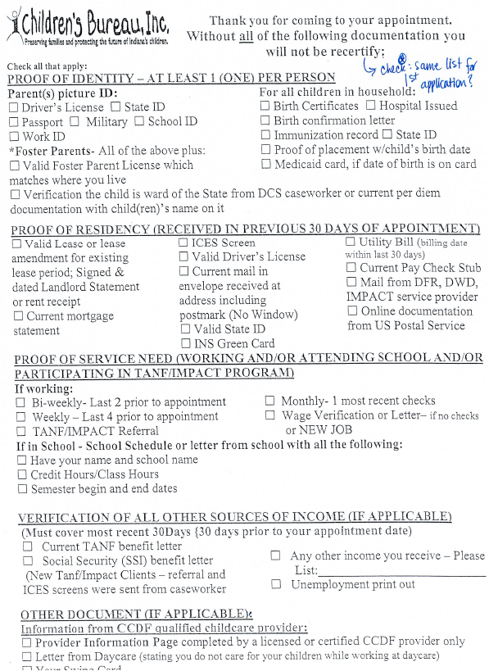
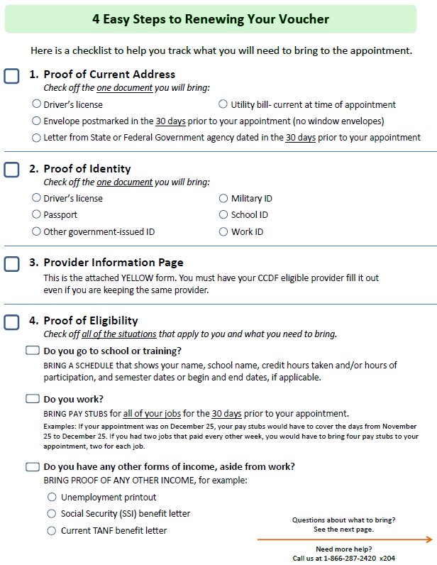
Example: Reduce Cognitive Demands

Slide 21
Example: Creating Community Support for a Goal-Setting Framework (Routt County CO)
Talk it Up – Engaging community partners
Step it Up – Six week goal setting group
Move it Up – Individualized education and employment activities

Slide 22
Example: Online Goal Achievement (Larimer County CO)
Automate routine processes to free up staff time to provide more one-on-one support
Create milestones in different domains – breaking tasks into discrete and manageable steps; examples include
Exploring careers
Applying for child care
Registering for school or training
Job search monitoring and management
Integrate tracking of hours with online completion of milestones
Provide more immediate feedback to participants when tasks are completed (e.g., use of non-monetary incentives to create and sustain motivation)

Slide 23
TuaPath

Slide 24
Next Steps
Development of tools for the field: goal-setting process; planning with a focus on small steps; intentional planning and review process
Call for action to innovate -- design and implement a goal achievement/executive function-informed employment or human service program
Start small - engage in a fast-cycle learning process
Share successes (and failures) with others -- participate in a “learning community” of states and localities
Commit to evaluate – “build the evidence”

Slide 25
For More Information
LaDonna Pavetti – Pavetti@cbpp.org
Michelle Derr – mderr@mathematica-mpr.com
Also visit: www.buildingbetterprograms.org

