Slide 1
Executive Function Skills for Adults: What They Are and Why They Matter

Slide 2

Adult Executive Functions
Silvia Bunge
Director, Building Blocks of Cognition Laboratory
Professor, Department of Psychology &
Helen Wills Neuroscience Institute
University of California at Berkeley
http://bungelab.berkeley.edu

Slide 3
Outline
What are EFs, and why do they matter?
When & how do EFs develop?
Which factors influence EFs?

Slide 4
Self-Reported Executive Functioning
Items from the Dysexecutive Questionnaire (DEX):
I have trouble making decisions, or deciding what I want to do
I have difficulty thinking ahead and planning for the future
I find it difficult to keep my mind on something, and am easily distracted
I act without thinking, doing the first thing that comes to mind
I lose my temper at the slightest thing
I am unaware of/unconcerned about how others feel about my behavior
I have difficulty realizing the extent of my problems

Slide 5
Our behavior lies along a continuum
Reactive
Impulsive
Proactive
Goal-directed
Right now!
Time Orientation
Future
One
Factors considered
Multiple
Self
Focus
Self & others
EFs: skills that support
goal-directed behavior
Notes:
Imagine an individual as a seesaw. Poverty and chronic stress tip the seesaw out of balance, but economic assistance and capacity-building can help to counteract these forces. There are multiple ways in which negative environmental influences can tip the balance ---- I’ll give you two examples. The first is in the realm of time orientation: what kind of time-period you think about and act on, ranging from right now to a long time in the future. Negative factors tip the balance towards a focus on ‘right now’, leading to reactive, impulsive behavior. We want to find ways to counteract this tendency, encouraging individuals to plan ahead, resisting impulses & making good decisions.

Slide 6

Factors that influence behavior
Financial instability
Chronic stress
Behaviors & programs that combat life challenges, reduce stress levels, and build EF skills
Reactive,
impulsive
behavior
Proactive,
goal-directed
behavior
Notes:
Imagine an individual as a seesaw. Poverty and chronic stress tip the seesaw out of balance, but economic assistance and capacity-building can help to counteract these forces. There are multiple ways in which negative environmental influences can tip the balance ---- I’ll give you two examples. The first is in the realm of time orientation: what kind of time-period you think about and act on, ranging from right now to a long time in the future. Negative factors tip the balance towards a focus on ‘right now’, leading to reactive, impulsive behavior. We want to find ways to counteract this tendency, encouraging individuals to plan ahead, resisting impulses & making good decisions.

Slide 7
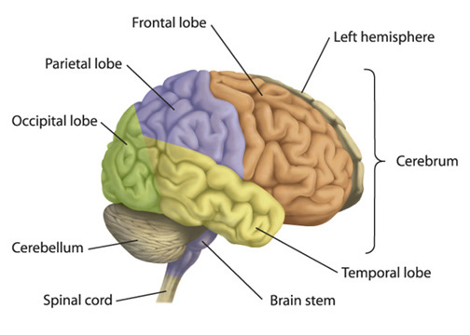
Adult EF skills
Framework based on skills that adults need to get & keep a job, pay rent, care for children, etc.
Informed by cognitive neuroscience research
Slightly different from framework commonly used to describe EF skills in children (working memory, inhibitory control, cognitive flexibility)
Prefrontal cortex
PLANNING
SELF-CONTROL
MONITORING
Notes:
Planning makes it easier to regulate,…

Slide 8
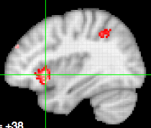
SELF-CONTROL
  Controlling one’s
      Thoughts
      Feelings
      Behavior
Meta-analysis conducted with Neurosynth
  Examples:
  Not getting distracted from a goal
  Not making an impulse purchase
  Not getting angry
Notes:
The third one is self-regulation, or self-control. This is the ability to control one’s ………

Slide 9
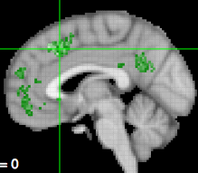
MONITORING
Moment-by-moment awareness of…
Thoughts, feelings, behavior
Performance, progress
Surroundings, context
Others’ behavior
Meta-analysis conducted with Neurosynth
  Examples:
  How well am I doing?
  Is my behavior appropriate in this setting?
  What is she thinking?
Notes:
The second core capacity is monitoring, or awareness. To behave appropriately, it’s important to be self-aware – to know the answers to these questions…
It’s also important to be able to monitor others; behavior ---
Example: I’m getting really upset. I’m going to need to calm down before I say or do anything I’m going to regret later.

Slide 10
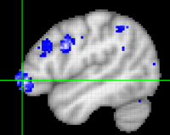
PLANNING
  Identifying long-term goals
  Identifying obstacles and possible solutions
  Specifying steps needed to achieve goals
  Setting appropriate deadlines & reminders
Meta-analysis conducted with Neurosynth
  Examples:
  Drafting a household budget
  Identifying steps needed to prepare a job application
  Making arrangements for child-care
Notes:
The first of these core capacities is the ability to plan, or to engage in proactive behavior. This mean,s being able to identify long-term goals, and possible obstacles and solutions. Being able to lay out concrete steps needed to achieve these goals, and to set appropriate deadlines & reminders to make sure that they happen.

Slide 11
Adult EF skills are inter-related
Long-term goal: Get healthier
Specific goal: Exercise after work
PLANNING
SELF-CONTROL
Pack exercise clothes before leaving for work
Turn down dinner invitation
MONITORING
Make sure that behavior is consistent with the goal
Notes:
Planning makes it easier to regulate,…

Slide 12
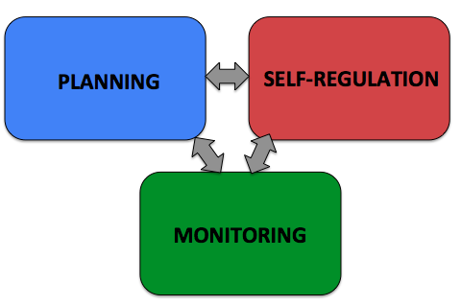
Self-Reported Executive Functioning (DEX)
I have trouble making decisions, or deciding what I want to do
I have difficulty thinking ahead and planning for the future
I find it difficult to keep my mind on something, and am easily distracted
I act without thinking, doing the first thing that comes to mind
I lose my temper at the slightest thing
I am unaware of/unconcerned about how others feel about my behavior
I have difficulty realizing the extent of my problems
SELF-CONTROL

Slide 13
Outline
What are EFs, and why do they matter?
When & how do EFs develop?
Which factors influence EFs?

Slide 14
Development of EF-dependent behaviors
Laboratory tests
Psychosocial Maturity Index
% of individuals scoring at average adult level
55
45
35
% of individuals in age group
25
15
5
10-11
12-13
14-15
16-17
18-21
22-25
26-30
Age (years)
Steinberg et al., 2007
Notes:
3 widely used and well validated Likert-scale type instruments for assessing
Risk perception (the extent to which one perceives a potentially dangerous or harmful activity as risky) – 8 items,
Sensation seeking (extent to which one actively seeks experiences that provide thrills) – 6 items
Impulsivity (extent to which one acts without thinking or has difficulty controlling impulses) – 18 items from the Barrat Impulsiveness Scale (subscales test for motor impulsivity, inability to delay gratification, lack of perseverance)
Last two: new response format created by Harter to reduce the social desirability bias. Very true or sort of true of them.
4.RPI – Validity of measure from study of serious juvenile offenders – presence of antisocial peer more correlated with own criminal behavior
5. Future orientation – Towers of Hanoi, delayed gratification task
Composite psychosocial maturity index formed by standardizing, reverse-scoring (impulsivity and sensation-seeking), and averaging the five measures

Slide 15
Psychosocial Maturity Index
Steinberg et al., 2007
Impulsivity | “I do things without thinking.”
Sensation Seeking | “I sometimes like to do things that are a little frightening.”
Risk Perception | “If you did this activity (e.g., had unprotected sex), how much are you at risk for something bad happening?”
Resistance to Peer Influence | “Some people think it's better to be an individual even if people will be angry at you for going against the crowd. BUT Other people think it's better to go along with the crowd than to make people angry at you.”
Future Orientation | “Some people take life one day at a time without worrying about the future BUT Other people are always thinking about what tomorrow will bring.”
Notes:
3 widely used and well validated Likert-scale type instruments for assessing
Risk perception (the extent to which one perceives a potentially dangerous or harmful activity as risky) – 8 items,
Sensation seeking (extent to which one actively seeks experiences that provide thrills) – 6 items
Impulsivity (extent to which one acts without thinking or has difficulty controlling impulses) – 18 items from the Barrat Impulsiveness Scale (subscales test for motor impulsivity, inability to delay gratification, lack of perseverance)
Last two: new response format created by Harter to reduce the social desirability bias. Very true or sort of true of them.
4.RPI – Validity of measure from study of serious juvenile offenders – presence of antisocial peer more correlated with own criminal behavior
5. Future orientation – Towers of Hanoi, delayed gratification task
Composite psychosocial maturity index formed by standardizing, reverse-scoring (impulsivity and sensation-seeking), and averaging the five measures

Slide 16
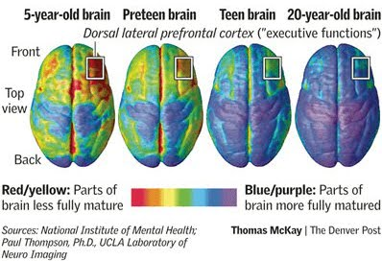
Why do EFs develop so late? Because prefrontal cortex is still maturing until our mid-twenties

Slide 17
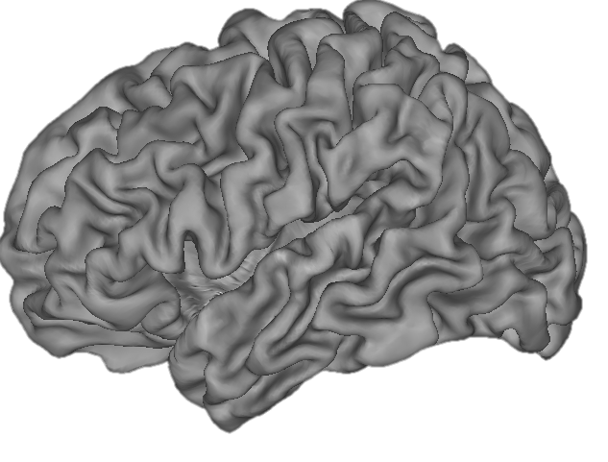
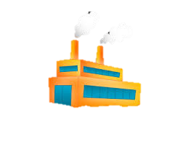
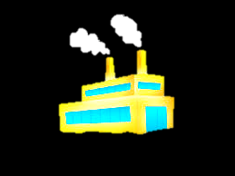
Development of brain networks
Across childhood & adolescence:
increased efficiency of function within regions
increased communication between regions
Notes:
At the cellular level, the individual houses are built based on connections, or synapses, between hundreds of thousands of neurons. Then, the activities of these households are streamlined through synaptic pruning --- selective elimination of some of the points of contact between neurons, which simplifies the system. Finally, the roads connecting distant neighbors are made stronger – the country roads become super-highways – through a process called myelination.

Slide 18
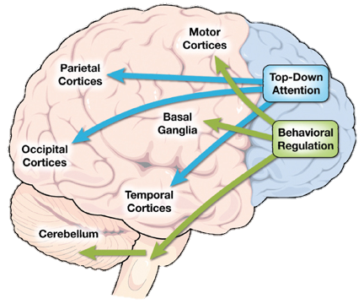
EF skills require communication between prefrontal cortex and other brain regions
“top-down”
processing:
focusing on
goal-relevant
information &
responses
“bottom-up”
processing:
reacting to
external cues
Arnsten, Berridge, & McCracken, 2009

Slide 19

Windows of vulnerability & opportunity for the developing brain
The brain is most sensitive to environmental factors (for better or for worse) while it is still developing
Each brain network has its own developmental timecourse
Therefore, the window of greatest opportunity & vulnerability depends on the brain network
Notes:
There are two really important points to be made about windows of plasticity.

Slide 20
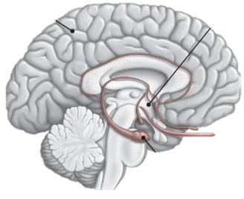
Windows of vulnerability & opportunity for specific brain networks
Basic emotional circuitry matures early
Neglect/abuse in first few years of life can have long-lasting effects on social and emotional functioning (Nelson & Fox)
EF circuitry matures late
Early environmental influences are less likely to permanently affect it (Fox & Nelson)
Strengthening EF skills could help to cope with deficits in other areas

Slide 21
Outline
What are EFs, and why do they matter?
When & how do EFs develop?
Which factors influence EFs?

Slide 22



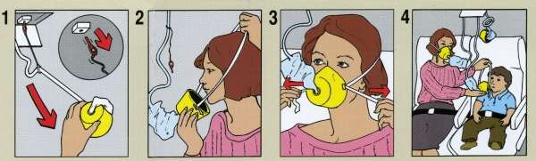
Factors that influence EFs on a daily basis

Slide 23


The importance of getting good sleep
Prof. Matthew Walker, UC Berkeley
https://www.youtube.com/watch?v=51e2NEmuI7I
Prof. Allison Harvey, UC Berkeley
https://www.youtube.com/watch?v=EMdaQMlXF-Q

Slide 24
The importance of exercise
Short-term benefits (same-day)
Increased blood flow to the brain, bringing vital nutrients to cells
Effects on mood, stress, and EFs that last for several hours
Long-term benefits (after several months)
Leads to formation of new neurons & connections in the brain
Improves resilience to stress, lowering hormonal response to stressors

Slide 25
Factors that influence EFs over the longer term
Factors that influence brain development have long-lasting effects
Prefrontal cortex is particularly sensitive to the environment For review see Mackey, Raizada, & Bunge (2012), http://bungelab.berkeley.edu
Prefrontal cortex

Slide 26
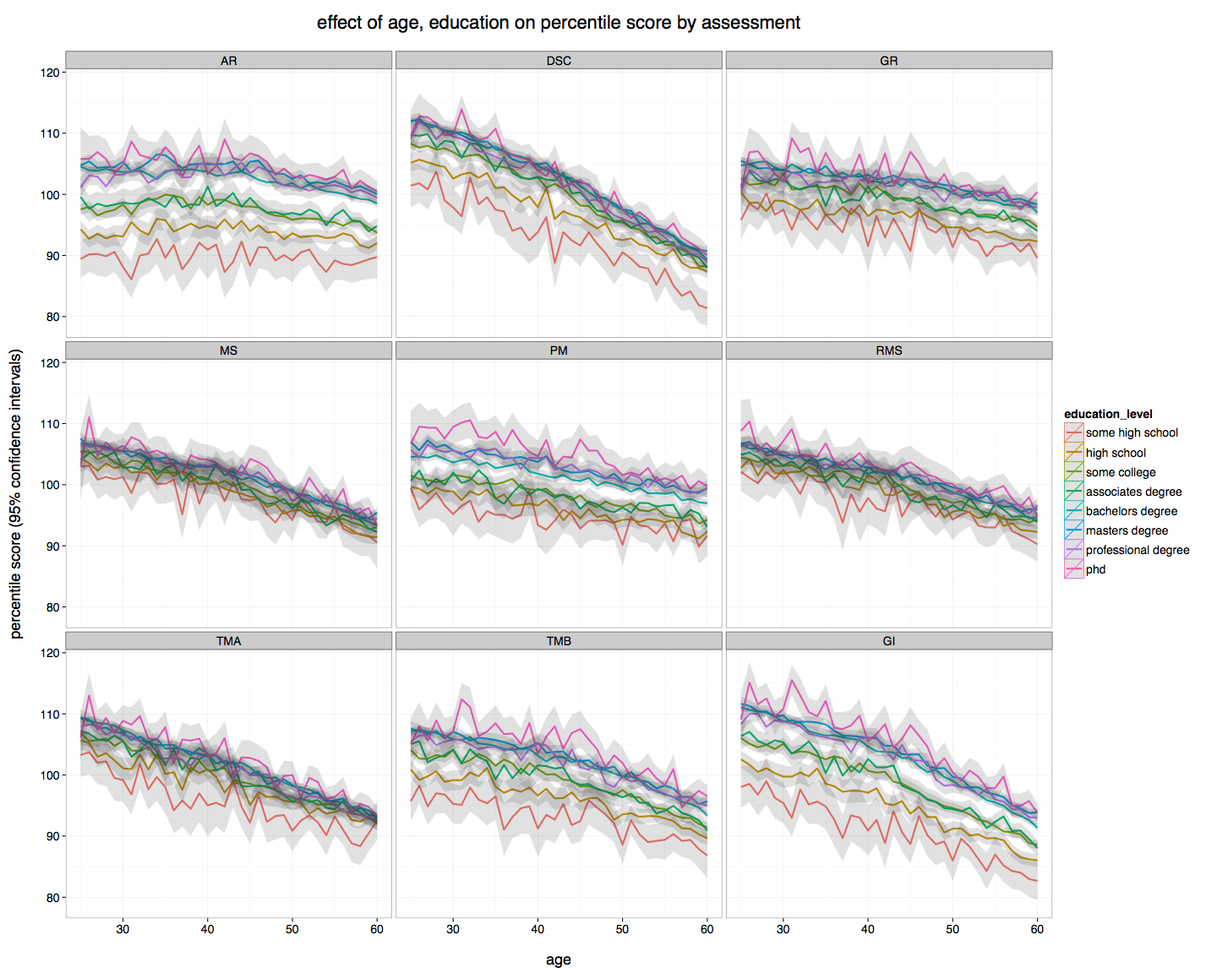
Lumos Labs data from over 176,000 adults
120
110
Grand Index (normed)
100
90
25
30
35
40
Age (years)
Notes:
EF skills vary widely among adults, and education is an important factor. In fact, even though everyone shows declining EF skills with age, a 40-yr-old with an associate’s degree performs as well as a 25-year-old with only a high school diploma. And the results are even better for those who have obtained a Bachelor’s degree or above. Now, there’s a chicken-and-egg problem here: what comes first, EF skills or education? People with better EF skills are more likely to pursue higher education, but it’s also probably the case that education hones EF skills well into adulthood.

Slide 27
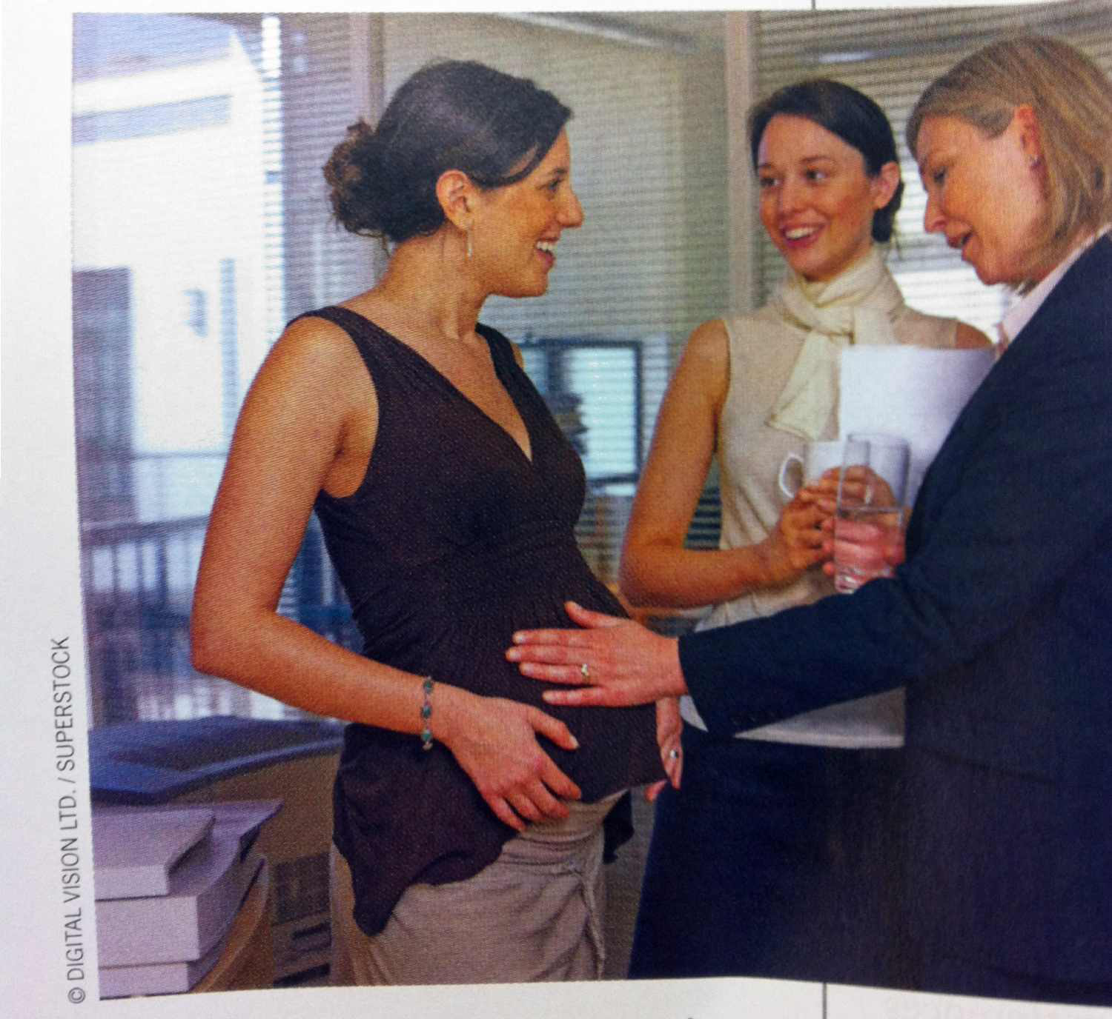

Influences on prefrontal cortex development
    Negative influences
    Malnutrition
    Exposure to drugs, toxins
    Neglect, abuse
    Brain injury
    Chronic stress
    Positive influences
    Higher socioeconomic status (many factors)
    Exercise?
    Cognitive training?
    Mindfulness?
Notes:
most maternal pesticide exposure probably occurs through the diet, as is the case for the
general U.S. population, but with additional residential non-dietary exposure most likely from
ingress of pesticides from agricultural use into homes

Slide 28
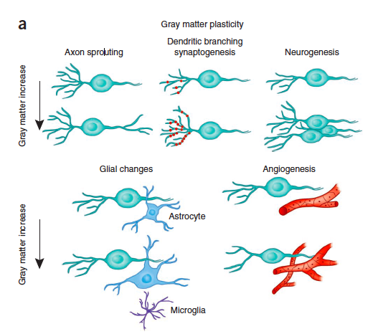
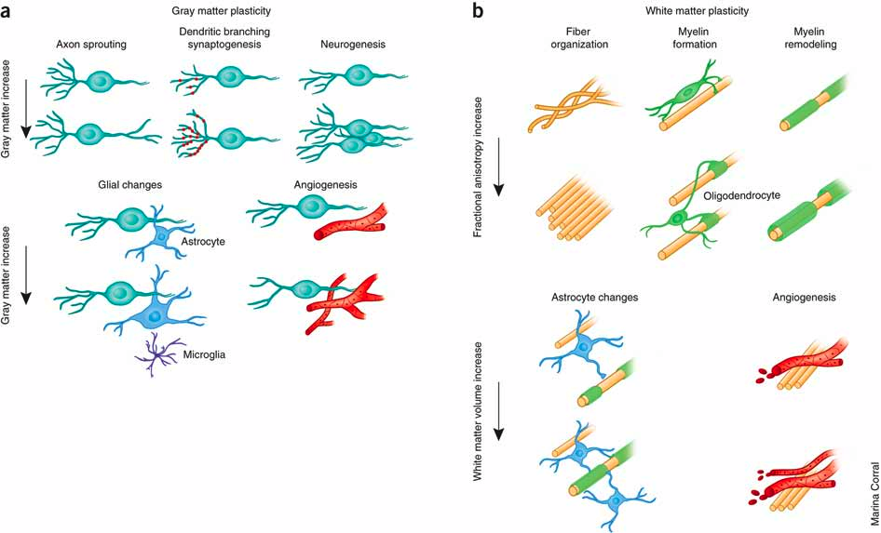
Ways in which the environment shapes the brain
# connections between neurons
Speed of communication
# support cells
Blood vessels
Zatorre et al, Nat Rev Neuro, 2012

Slide 29
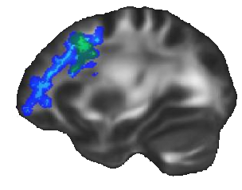
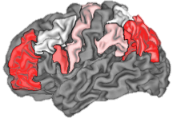
Prefrontal cortex is sensitive to experience even in adulthood: Effects of 3 months of reasoning training
Structural changes
Changes in prefrontal white matter tracts
Functional changes
Increased communication between prefrontal cortex
and other regions
Mackey, Whitaker, & Bunge, Frontiers in Human Neuroanatomy, 2012
Mackey, Miller Singley, & Bunge, Journal of Neuroscience, 2013
http://bungelab.berkeley.edu

Slide 30
Promising approaches to
EF skill development in adults?

Slide 31


2 types of programs that target adult EF skills
Field-based interventions
Not necessarily called EF interventions, but may tap into one or more EF skills
Designed with needs of constituents in mind, targeting the real-world challenges they face
Often involve face-to-face interactions
Effectiveness may or may not have been evaluated rigorously
  http://www.tedxbeaconstreet.com/beth-babcock-science-reshaping-poverty/

Slide 32
2 types of programs targeting adult EF skills
Laboratory-based cognitive training
Derived based on years of research
Well-controlled studies
Precise data collection
Focus on strengthening specific EF skills
Often computerized
Training is not directly linked to real-life challenges, but rather focuses on general EF skills that, in theory, should transfer to improved functioning in daily life

Slide 33
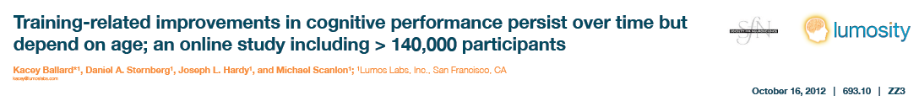
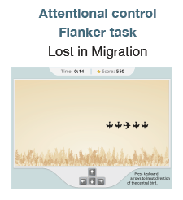

Slide 34
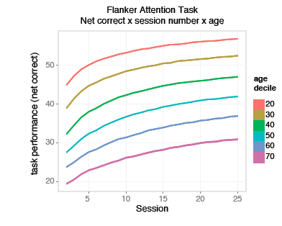

Slide 35
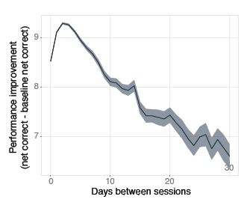
Benefits are greatest when training every other day or so (distributed practice)

Slide 36
Laboratory-based cognitive training
Powerful approach for developing & rigorously assessing science-based interventions
Important considerations:
  Repetition of the same task many times ("drill and kill") doesn’t account for the pivotal role of motivation in learning
    Some programs emphasize gamification and variety, both of which boost motivation
  A focus on isolated cognitive skills ignores research showing limited transfer of skills from one setting/context to another
    Some programs use many exercises to try to train multiple skills rather than just one
  To solve real-world problems, we need to work backwards from what we want to achieve

Slide 37

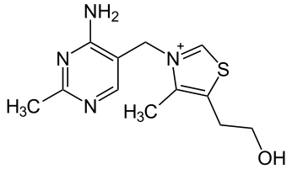

Analogy to nutrition science
Isolation of essential nutrients
Thiamine (Vitamin B1)
First identified in 1926
Functions in brain & body are now well-understood
Can diagnose & treat B1 deficiency, preventing illness & death
Vitamin craze
‘Whole food’ movement –
but now we can treat people
with specific nutritional deficiencies

Slide 38



Promising approach to EF skill development
Combine the strengths of field-based and laboratory-based interventions
  Form partnerships between scientists, practitioners, and industry to identify, develop, & test interventions that build on existing science to address real-world problems
  Example:
  Science shows that EF skills are essential ingredients for life, and that they can be strengthened with practice
  Two-generational approaches to EF skill development in parents & their children may produce sustainable change
Notes:
Analogy to food science –
Biochemists…

Slide 39
www.buildingbetterprograms.org

