Slide 2
Executive Function: A new Frontier for Workforce and Other Programs that aim to Build Adult Capacities
Enhanced Coaching Pilot

Slide 3
Partner
Goodwill/Easter Seals MN
Co-create
Co-present
Co-sponsored
Co-shared vision, mission and value
Co-believe
Evaluation/outcome drive

Slide 4
Covered Today
Starting
Why it is important
Life Long Learning
Emerging Service Strategies and Interventions
Enhanced Coaching Project
Evaluation

Slide 5
Start 2012-2013
FAST Program
Preparation for the overall RFP
Evaluation and Research
Review of current outcomes
Review and understanding of current Labor Market Conditions in MN
Creating a vision for the Ramsey County MFIP/DWP system ( share vision hand out)
Setting import key goals-engagement, education, employment, employment retention
WIOA
DHS goals
Change in MFIP educational policy
Emerging research
Cuts in funds
Ramsey County Board Goal
WIB Goals and Strategic Planning

Slide 6
Start
Who are these Families
Growing number of FSS Families
Long Reach of Early Childhood Poverty
Experience with transitional work and FSS
Experience with SSI advocacy service

Slide 7
MFIP/DWP system assessment
No real change in Employment and Engagement outcomes
Focus on process and not outcomes
Focus on case management vs. coaching
Focus on being an expert as staff vs believing that participant is an expert
System that supported disabilities vs seeing abilities

Slide 8
2013 RFP
Ramsey County RFP
Defining a need for a better outcome based system

Slide 9
2014 Training/Education
System training and education
System change
Advocacy for the change
Creating of new tools
Investing into families

Slide 10
From Theory to Practice 2015-2018
Life Long Learning- adults can learn
A Caution
“Executive Functioning Disorder” is a diagnosis used by some medical communities. Please take heed as we are using this a skill development strategy and not as a diagnostic tool!
While everyone can benefit from
idea of “lifelong learning,” not
everyone in poverty has “diminished
EF capacity.”
Approach from a strength-based
point of view.

Slide 11
A Story Worth Sharing
“Furthermore, when we engage with children who may have heard negative words that instill self-doubt, that then fuel negative or challenging behaviors, it is critical that we arm ourselves with tools and strategies to provide a counter-story. We must give, instill and demonstrate an image of strength in our children; assuring them that we see and believe in their greatness and
in their potential.”
Gevonee Ford, NdCAD
Remember the same philosophy holds true for all of us including the participants and their children.

Slide 12
Fundamental Concepts
Strength based approach to program design and mentoring
Encourage participant voice and engagement
Motivate participant and work with motivated participant
Support each step family takes, reward effort
Respect the rights and dignity of the family, appreciate diversity and views, opinions and experiences
Grow social capital through peer networks, coaches and community

Slide 13
My Bridge of Strength and Gap
Co Created with staff
Adopted from CWU and Employability Measure DHS
Done by the participant
Counselor is coaching and helping participant to move forward
Co-investment, intervention match the client’s level of investment with similar program investments
Creating networks
Setting SMART GOAL
Teaching how to set a SMAT GOAL

Slide 14
Values
Strength-based approach to program design and mentoring
Encourage participant voice and engagement in program design and evolution
Support private steps families take to strengthen or improve family of independence
Respect the rights and dignity and appreciate the diversity and range of view, opinions and experiences
Utilize defined selection proves in program, eligibility criteria and distribution of rewards
Seek to grow social capital through peer networks, mentors, and community leadership skills.

Slide 15
My Bridge of Strength
Blend a strength-based approach with an assessment to clarify participant’s goals and construct participant plans
Participant-centered, strength-based, coaching tool that supports participant’s life long learning
Help participant and counselor to learn ways in which the participant increased their role in choosing one’s goal while working within MFIP requirements
Use of Motivational Interview and Coaching to solicit information

Slide 16
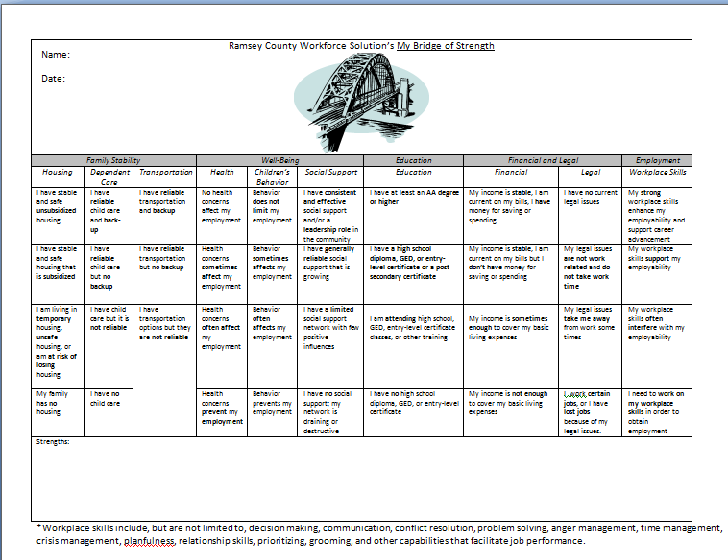
Ramsey County Bridge of Strength

Slide 17
SMART GOAL
Specific
Measurable
Attainable
Relevant
Time-limited

Slide 18
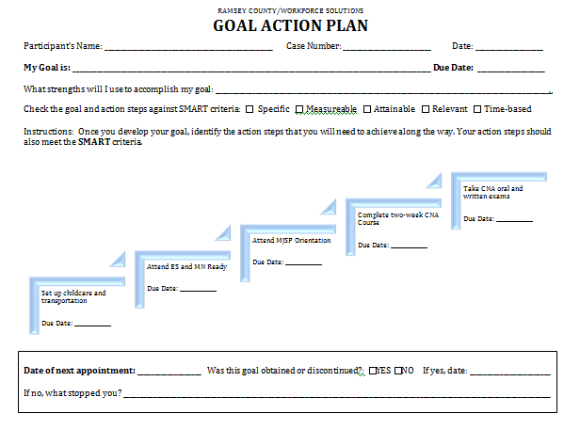
Goal Action Plan

Slide 19
Evaluation
Staff Focus Group
  One September 2014, One March 2015
Participant Focus Groups
  Two September 2014, Two March 2015
Staff Evaluations
Participant Evaluations
Administrative Data – Descriptive Analysis

Slide 20
Since you started using the Bridge, what has been your most positive experience?
  Goals: Participants that previously didn’t come in, now show up for appointments because they have goals and they are meeting them.
  Attitude changes: Noticeable improvement and it shows in results.
  Home visits: “What is best able to do with Bridge is going and doing home visits, getting to know their situations and their families.”
  Additional Quotes:
      “Since implementing the Bridge…very positive…is the collaboration between staff and myself. We work as a team because the best way to success is through team work.”
      “Using Motivational Interviewing to go through the Bridge completion work.”
      “I just developed three action plans with a client who has usually been hard to work with…she is really taking advantage of the opportunities coming to her.”
      “I use the Bridge with housing clients and with a housing advocate present so we can blend the dual expectations into one plan…all tied together.”
Evaluation
Since staff started using the Bridge, what has been your most positive experience?
  Goals: Participants that previously didn’t come in, now show up for appointments because they have goals and they are meeting them.
  Attitude changes: Noticeable improvement and it shows in results.
  Home visits: “What is best able to do with Bridge is going and doing home visits, getting to know their situations and their families.”
  Additional Quotes:
      “Since implementing the Bridge…very positive…is the collaboration between staff and myself. We work as a team because the best way to success is through team work.”
      “Using Motivational Interviewing to go through the Bridge completion work.”
      “I just developed three action plans with a client who has usually been hard to work with…she is really taking advantage of the opportunities coming to her.”
      “I use the Bridge with housing clients and with a housing advocate present so we can blend the dual expectations into one plan…all tied together.”

Slide 21
Evaluation
From staff perspective, how have participants received the Bridge concept?
  Doorway - “They are receiving it...they have a lot of barriers…Bridge is a doorway to address them…”
  Choices - “Happy getting to make more and broader choices.” “…people see how all difficult aspects of life are tied together…leads the client to identify and make choices.”
  Empowering - “When we tell them it is empowering them, they open their eyes.”
  Barriers to Potential - “Be sure to explain to not only see barriers but through explanation they can see how it can open…”
  Counselor skills - “Is also a learning process for counselors...”
  2-way learning - “Helpful for clients to do the Bridge with the counselor…gets more information and interaction.”
  A discussion about when to discuss the Bridge with participants is incorporated into ongoing training.

Slide 22
Evaluation
Participant Focus Group (4)
Was the Bridge of Strength your first attempt to set goals with your employment guidance counselor?
  Yes (4) Previous counselor told them what to do, but weren’t very interested in their personal goals.
  All completed goals and one already received a job offer, another expects an offer, and the other two have enrolled in education.
  Deadlines are very helpful, they already know they need to get a job, but the goals along the way are necessary and they appreciated being pushed to achieve the goals they set for themselves. They felt involved in the process for the first time.

Slide 23
Evaluation
How easy or difficult was it to focus on your strengths as you completed the Bridge of Strength?
  A lot at first, but encouragement of ES counselor really helped
  Motivation was noted by many, needed to feel motivated and focusing on their own goals made that easier than focusing on someone else’s goals.
  Another participant thought the process was easy and one even thought it was too easy, until it came to achieving the goals, but the pressure was a good thing.
What did you like the most about the Bridge of Strength?
  Deadlines and variation in short, medium, and long-term goals (not just “get a job”)
What did you like the least about the Bridge of Strength?
  It didn’t come soon enough (4)
Who do you think the Bridge of Strength could help?
  The Bridge motivates, everyone could benefit.

Slide 24
Evaluation
36 (nearly 1/3) counselors using Bridge and Goal Action Plan since November, 2014.
Range from general caseload to targeted on new enrollees, teen parents, extended cases, racially and culturally specific and IPS service recipients.
Total number of participants engaging in the Bridge and/or Goal Action Plan is expected to be more than 100 by the time we conduct the March focus groups.

Slide 25
Evaluation
Evaluation: Moving Forward
Rapid Cycle Evaluation
  Evaluate outcomes from agency level.
  Additional staff and participant focus groups.
  Wrap into over plan and integrate into national evaluation.

Slide 26
Teach Families to Dream
Don’t be pushed by your problems; be led by your dreams.
If you imagine persistence as the engine of success, then courage is its fuel.
All dreams have an inherent risk to them. Part of the power of finding courage is in being able to recognize your fears and do what you need to do any way.
As you move toward a dream, the dream moves toward you. Julie Cameron
Obstacles are what you see when you take your eyes off your goals.
Become a possibilitarian. No matter how dark things seem to be or actually are, raise your sights and see the possibilities – always see them, for they’re always there. Norman Vincent Peale
Goals determine what you are going to be. Julius Irving

Slide 27
Goals Set by Someone Else
Individuals may be faced with problem situations and/or goals that others have set for them that they do not see as important. Hence, there is no internally generated motivation to activate and sustain goal-directed behavior. For this reason, and in the absence of internal motivation, it is important to externalize motivation. This means utilizing some artificial means to create an extrinsic source of motivation.

Slide 28
Goals Set by Individual
When an individual has a goal that is important to her, behavior in the service of obtaining that goal can increase the likelihood of learning and practicing goal-relevant skills. Achieving that goal may well involve what we consider to be executive functions, such as working memory, flexibility, and response inhibition, among others. To the extent that they are important to the individual, goals offer a vehicle for the acquisition and practice of executive functions.

Slide 29
Benefits of Goal Setting
Goals serve four primary functions:
First, they direct behavior toward goal-relevant activities and away from goal-irrelevant activities
Second, they energize – high goals lead to greater effort than do low goals
Third, they encourage persistence
Finally, they motivate individuals to discover or use task-relevant knowledge or strategies

Slide 30
Employment Manual
“The EP must include the participant’s overall employment goal; activities and steps necessary to reach that goal.”
“The function of the EP is to identify the participant’s self-support and employment goals, breaking those goals into smaller objectives, and listing the steps the participant must take to achieve the goals in the shortest time reasonably possible.”
Always go back to Employment Manual
Activities that count are the same as activities that matter
Motivation and outcome based program maintain WPR level
Engaged participant- employment- leaving assistance with employment
Always tie your change to DHS/Ramsey County Board Goals

Slide 31
Lifelong Learning:Techiniques for staff
Lifelong Learning skill development techniques strive for more simplified and participant goal-driven content delivery, case management, and engagement strategies.

Slide 32
Techniques for Front Line Staff
Reduce noise- (literally) and other distractions in the environment such as messy desks or walls.
  Help children stay occupied with toys/crayons so parents can concentrate.
  Be consistent- plan ahead, return voicemails in a timely manner.
  Remember Details – helps to build rapport, ask about their children, work, school, etc.

Slide 33
Techniques for Front Line Staff
Serve and return content delivery: like tennis or volley ball, the interaction between participant and counselor must be responsive, interactive and Non-Authoritarian.
  Prepare for participant meeting – do not firmly follow your agenda, be flexible and listen to participant.

Slide 34
Techniques for Front Line Staff
Make program materials easy to read, relatable to the participant and limit jargon.
  After writing EP, go through each activity section (use highlighters).
  Assist clients with job logs (especially first time) and other forms.
  Accept FSS verbal documentation of activities if more convenient for participant.
  If referred to MN Ready or other workshops- may be helpful to print calendar so they know their schedule (make add wake time, time to feed children, etc).

Slide 35
Techniques for Front-Line Staff
Bundle services so that it’s easier for participants to gain all that they need for success. Help them with calendar and logistics planning, etc.
  Continuous Support – Help them along (CC application process, HRF), help to be their liaison between their FW and CCW.
  Communicate and Collaborate with other professionals they are working with (ARMHS worker, Mental health provider, Case Managers).

Slide 36
Techniques for Front Line Staff
Flexible readmission to programs- if a participant is engaged at ANY LEVEL, then work with them to help them reach their success- don’t always go to sanction as your first tool.
Staff training- do you recognize the impacts of stress on your life and others? Consider ways in which your own EF Skills are compromised.

Slide 37
Coaching
Major intervention, co-design based on RC System need
Support Motivational Interview
Issue RFP
Training for they full system for sustainability
PCG is our partner
Co- hort model (beginners, intermediate, train the trainer)
Special co-hort for admin and front line supervisor
Coaching from Top to the Bottom and Across
Partnered with My Bridge Of Strength and Goal Action Plan
Evaluation build in into delivery
Importance of consistency
Can be achieve in short term relationships

Slide 38
Space for Service Delivery
Lobby Redesign, family space
Resource center Redesign
Service delivery change –greeter station, information desk hubs, everyone engaged, goal plan
(Share Resource Center Vision)

Slide 39
Coaching is
Asking powerful questions
Assist individual in establishing and attaining personal, long term multi-faceted goals for life improvement
Coaching for life change and complex individual goals’ attainment, including referrals and developing of networks
Tracking individual program towards long term goal, individual outcomes that lead towards program outcomes ( share report card, talk about data specialists)
Goal includes personal growth and sustained change in behavior that leads towards economic independence

Slide 40
2015-2018
Create family centered system that helps families to get education , find and sustain employment, reduce isolation and create prosperous communities
Service delivery at home, community sites and in the offices
Have 2-4 major evidence based interventions that work for multiple families
Invest funds based on a need of families and level of intervention

Slide 41
2014-2018 System Vision
Increase opportunities for improved employment and family stability, support and impact economic prosperity
Help participant develop executive skills, strengthen their personal agency and self-determination, as well as choose and pursue the activities that matter in achieving goals for self –sufficiency

Slide 42
Next Steps
Bridge and Goal Action Plan (GAP) Pilot – Ended October 2014
GAP and Bridge System-Wide Implementation-April 2015
Coaching Training System Wide Implementation - 2015
Enhanced Coaching Pilot – September 2015
Young Adult and Teen Families Expansion - late 2016
System-Wide Implementation -2017

Slide 43
Enhanced Coaching Pilot Goals
Test comprehensive model that incorporates coaching with executive skills informed interventions, strategies & tools
Closely examine what interventions, strategies &tools work and what doesn’t work
Measure engagement, employment, retention and educational outcomes to determine effectiveness

Slide 44
Enhanced Coaching Pilot Feature
Culture and Systems Change
  ES Informed Practice Principles
  Executive Skills Sustainability Model
  Job Roles and Expectations, Hiring Practices
ES Methodology Created
  11 Key Executive Skills: Behaviors and Interventions
  Enhanced Coaching: Goal Focused, Short time horizon, small steps, intervention-based
  Goal-directed behavior incentives
  Groups Redesigned: organize, streamline information delivered and customize learning
  Environmental and Paperwork modifications: minimize distractions, streamline information
  Stress Reduction
  Peer Support
Concrete Tools and Strategies
  Goal Action Plan
  Bridge of Strength
  ES Questionnaire
  Self accountability check lists for staff and participants

Slide 45
Executive Skills Informed Practice Principals
All people have strengths and weaknesses with executive functioning skills.
Building executive functioning skills starts with the reduction or elimination of immediate stressors.
“Goodness of fit” between a person’s goals and her/his current (EFS) skill level is important for success.
Goal-setting is a critically important, active and client-owned process.
Small action steps over a short amount of time are critical for goal attainment.
Goal development and progress must be a concrete and an explicit process.
Teaching skills, modifying the environment and changing incentives are primary interventions for addressing executive functioning deficits.
Success is determined by the degree to which individuals confidently make their own decisions and are self-regulating and self-determining.

Slide 46
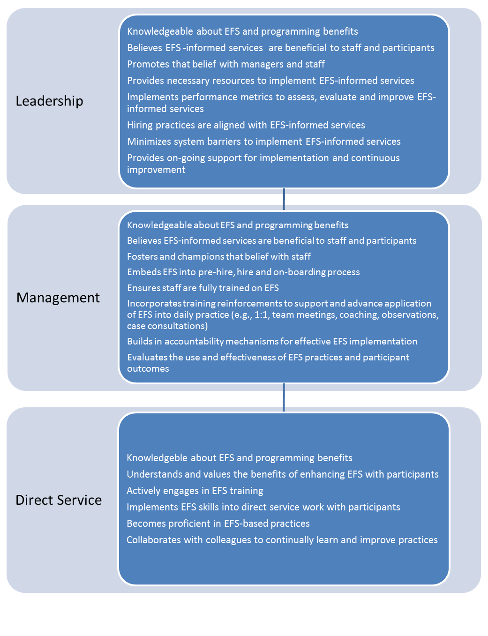
Executive Skills Informed Services Sustainability model

Slide 47
Thank you
Thank you
Questions, Feedback
Please contact
Kate Probert Fagundes
kate.prober@co.ramsey.mn.us
651-779-5655

