Slide 1
Components of an Executive Skills Informed, Goal-Oriented Job Search/Job Readiness Program
Presentation at the Executive Function Meeting
Washington, DC
February 2015
Michelle K. Derr

Slide 2
WOOP

Slide 3
Wish
Work in partnership with TANF agencies (at all levels) and our “dream team” to create an effective and feasible employment and training program that improves short- and long-term outcomes for low-income individuals and families.

Slide 4
Outcome
Improve long-term employment and parenting outcomes and general well-being.

Slide 5
Obstacle
Building a model that honors the evidence, but is simple to implement.
Moving quickly enough to capitalize on the opportunities and energy, but slowly enough to create a smart and thoughtful process.
Creating a model that is affordable for states and localities.

Slide 6
Plan
Actively contribute to the “dream team’s” vision, passion, and grit around this initiative.
Continue to involve both researchers and TANF agencies in the model development and implementation.
Create a thoughtful strategic plan that includes doable activities, useful products, and timely process.
Be fiscally conscious AND develop the “business case” for policymakers highlighting the opportunity costs of investing in this practice model.

Slide 7
WOOP Your Program
How do you see the executive skills and goal-oriented concepts playing out in your program?
What is the wish for your program?
What is your best outcome?
What is the main obstacle?
What is the plan?

Slide 8
What is “it”?

Slide 9
Draft Core Program Components
Goal
Attainment
Process
BEST Resources
Coaching
Organizational Integration

Slide 10
Goal Attainment Process
Set – Establish meaningful, achievable goals
Plan – Develop a plan for meeting goals
Act – Put the plan into action
Review/Revise – Review the plan to assess what worked and revise it as necessary
Worker serves as a facilitator—the client “owns” their plan
“Backward” planning process where there is an overarching goal with smaller steps to achieve it

Slide 11
Behaviorally-based Executive Skills and Troubleshooting (BEST) Resources
Resources for identifying and troubleshooting problem behaviors that interfere with goal attainment
Accessible, user-friendly tools for direct service staff
Modularized resources that are anchored in executive and other motivational skills
Recommendations for:
Reducing the things that impair executive skills (e.g., stress, lack of sleep)
Reducing the demands on executive skills
Building executive skills

Slide 12
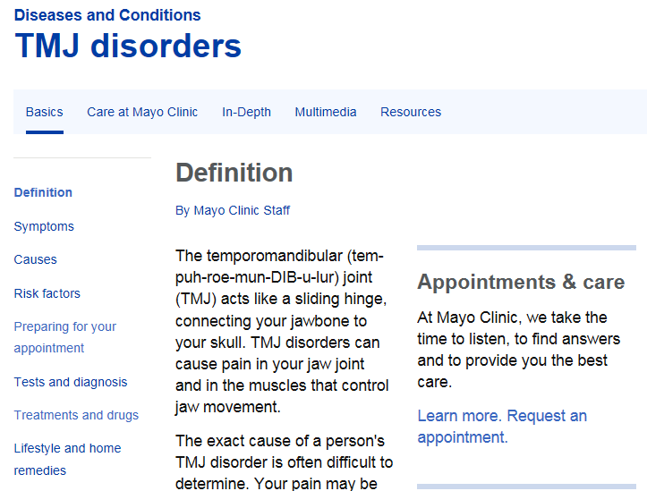
BEST Resources Example

Slide 13
Coaching
Progress is achieved through simple steps
Coach models healthy behaviors
Practice, practice, practice
Affirming, corrective feedback
Use of incentives and consequences to encourage desired behavior

Slide 14
Organizational Integration
Invest in a “top down,” “bottom up” approach
Infuse the goal attainment process and executive skills at all levels within the organization
Start the goal attainment process from the initial conversation and throughout service delivery

Slide 15
What might this look like in the field?
Implementation of different components of the pyramid
Possible mix of individual and group activities
Toolkit of resources to create quality, consistency, and fidelity in service delivery
Measures of progress and short- and long-term outcomes

Slide 16
How is this different than current practice?
Model is anchored in the best available evidence
Effort to change the framing and language that is empowering and still maintains accountability
Intentionality of smaller steps leading to bigger goals
Changes the relationship between direct service provider and client where the client “owns” the plan
Use of adult learning principles and dialogue education practices for staff training and direct service materials
Use of “test and tweak” approach where evaluation helps inform and improve policy and practice decisions

Slide 17
Next Steps
Strategic plan for process and partnerships
Deciding on model options and an implementation plan
Assessing existing fiscal and organizational resources and identifying additional needs
CBPP, Mathematica, Abt, Global Learning Partners
ACF (OPRE, OFA), state and local sites
Recruiting and developing “test sites”
Develop a flexible, evolving evaluation plan

Slide 18
Discussion questions:
What are your reactions?
What do you find useful?
What questions come up for you?

Slide 19
For More Information
Michelle Derr
MDerr@mathematica-mpr.com

