Slide 1
Executive Skills: A New Frontier for Workforce and Other Human Service Programs That Aim to Build Adult Capabilities
By LaDonna Pavetti
Vice President for Family Income Support
February 4, 2015

Slide 2
Why the Interest in Executive Skills for Adults?
Modest success, even in the most effective employment programs
Declining employment among single mothers with high school education or less for most of the last 10 years
Cash assistance provided to very few families
Evidence that if we teach “life skills” we can do better
Two-generation concerns: need to invest in adults to see big improvements in outcomes for kids

Slide 3
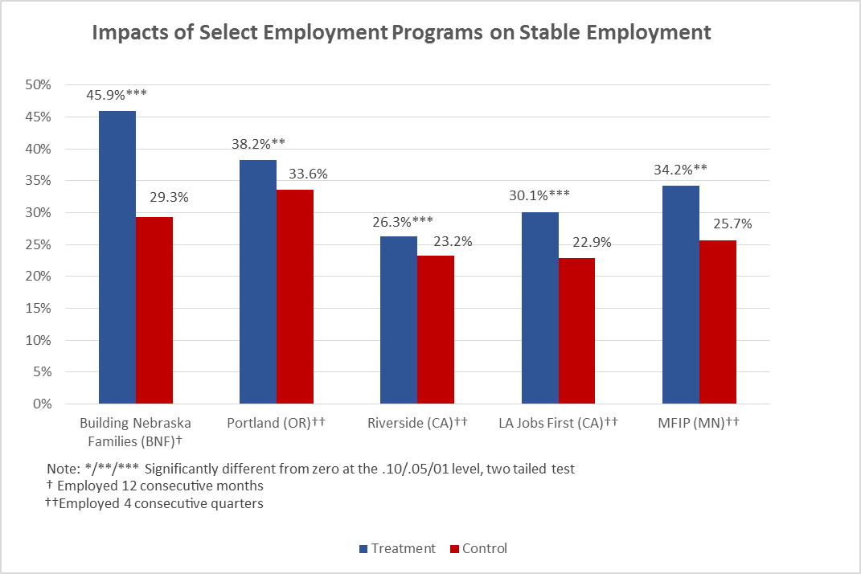
Evidence that moving in new directions could yield positive results

Slide 4
Impetus for applying executive function principles to programs for disadvantaged adults comes out of a concern for improving outcomes for children
Theory of Change Supporting A Focus on Adults
Frontiers of Innovation, Center on the Developing Child at Harvard University
Protecting children from the impacts of toxic stress requires selective skill building—not simply the provision of information and support—for the adults who care for them;
Interventions that improve the caregiving environment by strengthening the executive function and self-regulation skills will also enhance their employability, thereby providing an opportunity to augment child outcomes by strengthening the economic and social stability of the family; and
Community-based initiatives and broad-based, systems approaches are likely to be more effective in promoting healthy development and reducing intergenerational disparities if they focus explicitly on strengthening neighborhood-level resources and capacities that buffer young children from the adverse impacts of toxic stress.

Slide 5
Why Executive Skills Matter
Executive Function skills are critical for:
Job success – poor executive functions lead to poor productivity and difficulty finding and keeping a job (Prince et al. 2007)
Cognitive, social, and psychological development
Success in school and in life
For mental and physical health

Slide 6
What are Executive Skills?
One definition: conscious control of what we think and do; neurocognitive processes involved in goal-directed behavior (Phil D. Zelazo, Ph.D., Neuroscientist, University of Minnesota)
Useful to think of executive function as having two dimensions:
Process dimension: The steps we go through to achieve a goal
Skill dimension: The skills we draw on at each stage of the process in order to be successful

Slide 7
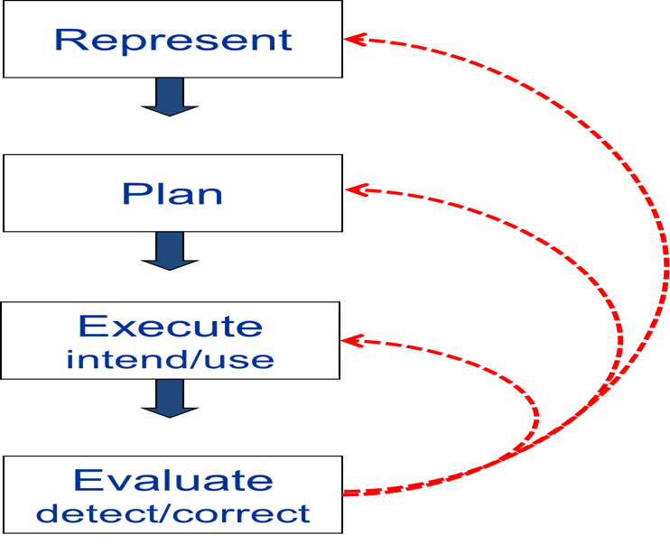
An Executive Function Framework Phil D. Zelazo, Neuroscientist, University of Minnesota
Notes:
Phil Zelazo at the University of Minnesota uses a slightly different iterative model:
Represent: What are my goals?
Plan: What do I need to do to achieve them?
Execute: The actions I will take
Evaluation: Assessment of my plan and my actions – what changes do I need to make?
Cycle repeats itself over and over

Slide 8
Executive Skills Peg Dawson and Richard Guare, Mental Health Practitioners and Authors
Skills Involving Thinking (Cognition)
Working memory: Ability to hold information in memory while performing complex tasks; incorporates ability to draw on past learning or experience to apply to current situations
Planning/prioritization: The ability to create a roadmap to reach a goal or to complete a task; making decisions about what’s important to focus on
Organization: The ability to create and maintain systems to keep track of information or materials
Time management: The capacity to estimate how much time one has, how to allocate it, and how to stay within time limits and deadlines
Metacognition: The ability to monitor oneself; ability to ask oneself – how am I doing or how did I do?
Skills Involving Doing (Behavior)
Response Inhibition: Capacity to think before you act
Emotional control: The ability to manage emotions to achieve goals, complete tasks, or control and direct behavior
Sustained attention: The capacity to keep paying attention to a situation or task in spite of distractibility, fatigue or boredom
Task initiation: The ability to begin a task or activity without undue procrastination and to independently generate ideas, responses, or problem-solving strategies.
Goal-directed persistence: The capacity to have a goal, follow through to the completion of the goal, and not be distracted by competing interests
Cognitive flexibility: The ability to revise plans in the face of obstacles, setbacks, new information, or mistakes
Stress tolerance: the ability to thrive in stressful situations and to cope with uncertainty, change, and performance demands.
From: Smart but Scattered by Peg Dawson, Ed.D. and Richard Guare, Ph.D., 2009
Notes:
Peg Dawson and Richard Guare use a very detailed list of skills, some that involve thinking (the representation, planning and evaluation/monitoring aspects of Bunge and Zelazo’s models) and some that involve doing – the action part of the equation.
Practitioners: want detail so they can target their interventions

Slide 9
Executive Function Processes and Skills Are Interconnected Silvia Bunge, Neuroscientist, University of California at Berkley
PLANNING
SELF-CONTROL
MONITORING
Notes:
Silvia Bunge, a neuroscientist at Berkley, has identified a three-element model of executive function skills:
Planning: What do I need to do to achieve my goals?
Self-Control: How can I control my behavior to stay on track?
Monitoring: How did I do and what changes do I need to make?

Slide 10
Goal Achievement and Executive Skills
Goal Achievement Process
Executive Skills
Purpose
Metacognition, working memory
Set
Establish meaningful, achievable goals
Planning/prioritization, time management, working memory, task initiation
Plan
Develop a plan for meeting goals
Task initiation, response inhibition, time management, sustained attention, working memory
Act
Put the plan into action
Review/ Revise
Metacognition, flexibility, working memory
Review the plan to assess what worked and revise it as necessary

Slide 11
Factors that Impair Executive Functions
Stress
Lack of sleep
Lack of exercise
Sadness
Loneliness
Poor nutrition
If we ignore that someone is stressed, lonely, or not healthy because of poor nutrition, lack of sleep or lack of exercise, those unmet needs will work against that person exercising the executive functions s/he needs to function properly at work and at home.
Adele Diamond
University of British Columbia

Slide 12
How Do we Improve Executive Function Skills?
Work on reducing things that impair executive functions such as stress, lack of connections and lack of sleep
Find ways to reduce the demands on executive function skills (e.g., change the environment, provide tools to make the task easier --like using a cellphone app for reminders; folders for organizing documents)
Work on explicitly building EF skills: break them into small steps, train them, challenge them and practice them in the context in which they will be used

Slide 13
Key Concepts for Improving Executive Function Skills: Motivation
Motivation is a critical building block for understanding and addressing executive function weaknesses.
What motivates adults:
Stress relief
Attainable goals and successes
Short-term, frequent and immediate incentives
Praise for effort
Independence and autonomous decision making
Having opinions valued
Deciding/negotiating what support they will need and having it available

Slide 14
Key Concepts for Improving Executive Function Skills: Effort
Effort expected needs to be consistent with some’s ability to engage in effortful work:
Using executive function skills, especially those that are weak, requires significant effort
Results in rapid energy depletion and susceptibility to doing things the way you’ve always done them
Need to modify task demands to match the person’s capacity for effortful work

Slide 15
Key Concepts for Improving Executive Skills: Short Time Horizons
Short time horizons are critical for helping to address executive skill weaknesses:
Short time horizons help in reducing stress by making people feel less overwhelmed
Short time horizons support breaking tasks into small steps
Small steps with short time horizons are an effective way to build early successes which in turn help to build or sustain motivation

Slide 16
Key Elements of an ES-Informed Approach
Setting Goals
Program expectations for an individual are consistent with their ability to successfully engage in effortful tasks.
Individual goals are challenging, but achievable and meaningful.
Intermediate goals that have a short time horizon are viewed as meaningful and are supported.
Planning
Plans are individualized and specific.
Plans provide a roadmap for reaching goals.
Plans are dynamic, not static.

Slide 17
Key Elements of an ES-Informed Approach
Action – Providing Supports for Success
The program helps individuals to recognize their executive skill strengths and weaknesses and helps them to identify ways to use their strengths to compensate for their weaknesses.
Coaching is used to facilitate achievement of a goal and development of skills; coaches act as a guide and facilitator through the stages of the goal-setting process.
The program helps individuals improve their ability to handle stress and/or helps them to reduce stress in their lives.

Slide 18
Key Elements of an ES-Informed Approach
Action – Providing Supports for Success (con’t)
The program understands and supports strategies for modifying the environment (or the task) to lessen the negative impact of executive skill weaknesses.
Opportunities for participants to build executive function skills are built into the program.
Incentives are used thoughtfully and systematically to help individuals maintain the effort and motivation needed to work towards achieving a longer-term goal.
Review/Revise
Processes for review and reflection are an integral part of the program.
Plans are updated regularly.

Slide 19
For more information
www.buildingbetterprograms.org (Executive Function and Webinar Tabs)
Pavetti@cbpp.org

