Slide 1
Applying a Rapid-Cycle Learning
Approach: The Family Mobility Project
CHARLES E. CARTER, JR., PH.D., LICSW
Chief Strategy Officer
Center on the Developing Child at Harvard University
How Can We Build an Evidence Base? Panel Presentation
Washington, DC | February 20, 2015

Slide 2
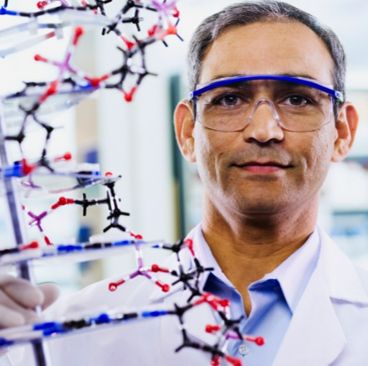
Our Mission
To drive science-based innovation
that achieves breakthrough outcomes
for children facing adversity
Our Work
The Center’s work focuses on two objectives:
Building an R&D platform that leverages science to catalyze the design, testing, and scaling of new intervention strategies
Transforming the policy, practice, and research landscape to support and drive change
Notes:
The mission of the Center on the Developing Child is to drive science-based innovation that achieves breakthrough outcomes for children facing adversity.
Our goal is meaningful change in policy and practice that produces substantially larger impacts on the learning capacity, health, and economic and social mobility of vulnerable young children. We aim to catalyze a new era in early childhood investment that mobilizes science to stimulate fresh thinking. We are particularly concerned about the needs of children who face the cumulative burdens of poverty, maltreatment, violence, racial and ethnic discrimination, and family mental illness.
In order to achieve those outcomes, our work focuses on two key objectives:
Building an R&D (research and development) platform that leverages science to catalyze the design, testing, and scaling of new intervention strategies
Transforming the policy, practice, and research landscape to support and drive change

Slide 3
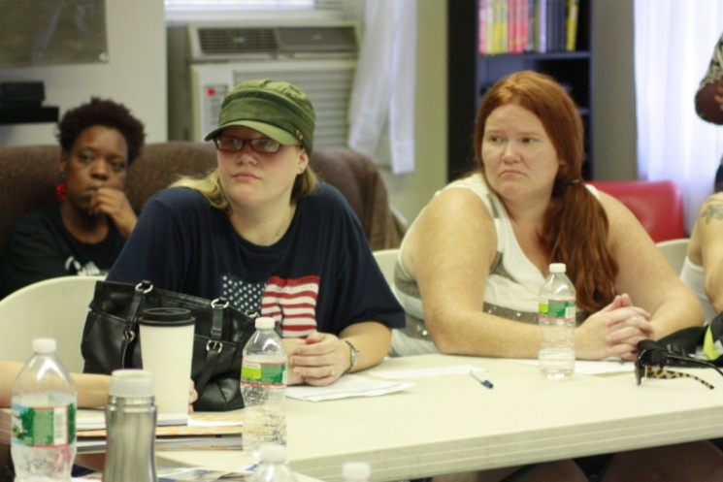
Rapid-Cycle Learning:
The Family Mobility Project
Developing a coaching model focused on shared goal setting with low-income families
Currently co-creating and piloting model with small number of families, incorporating feedback from parents and front-line staff
Notes:
The Family Mobility Project is a joint venture to design and test an innovative, intergenerational strategy to significantly improve the life prospects of young children and families facing the burdens of poverty.
This strategy is driven by a science-based theory of change and “on-the-ground” expertise about how to support both children and adults. It is based on the hypothesis that working in a coordinated way with each family member toward key goals will help the whole family achieve sustainable economic stability and positive developmental outcomes.
The heart of the Family Mobility Project rests on its seamless integration of Nurtury’s expertise in early care and education and CWU’s model of goal-setting and coaching for women living in poverty. Our aim is to develop, refine, and scale a hybridized intervention strategy that focuses on the common foundational capabilities of successful parenting and economic self-sufficiency by supporting families to set and attain educational, financial, and career-related goals.
The project will begin with a pilot testing phase with a small number of families which will incorporate feedback from both parents and front line staff before proceeding to replication. Using “design-test-iterate” as an accelerated method to develop and scale new interventions, preliminary approaches will be co-developed by a team of key stakeholders (including service providers, content experts, and participating parents), piloted in a real world setting, modified based on experience, and tested again with a larger group.

Slide 4
CHARLES E. CARTER, JR., PH.D., LICSW
Chief Strategy Officer
Center on the Developing Child at Harvard University
charles_carter@harvard.edu
(617) 496-1817

