Slide 1
Opportunistic Experiments and
Rapid-Cycle Evaluation

Slide 2
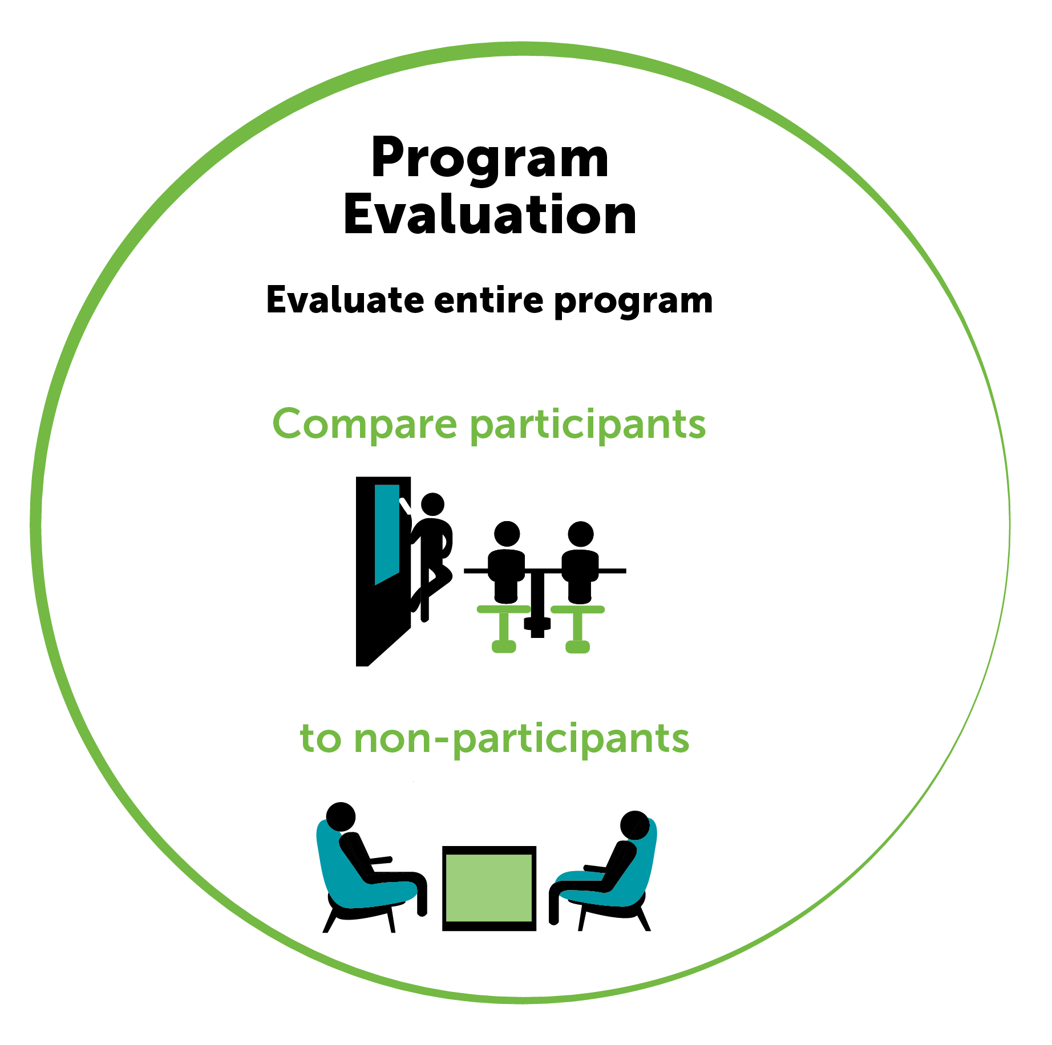
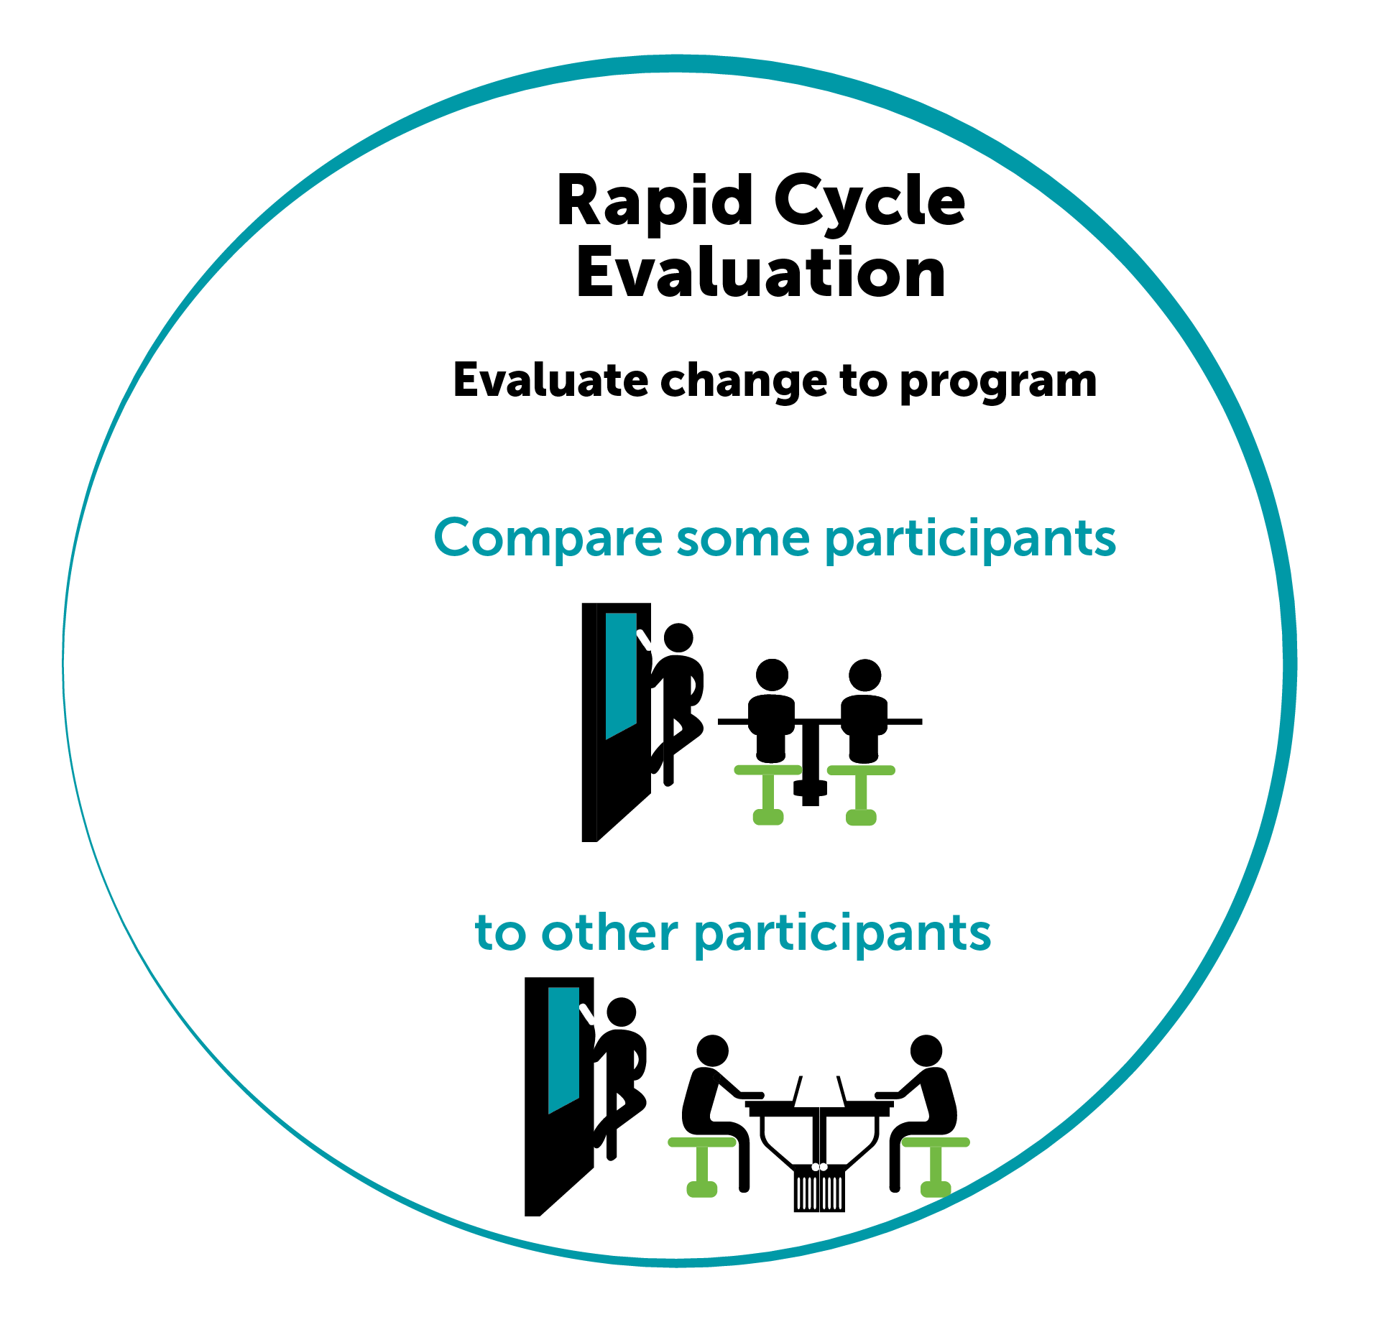
Why Evaluate?

Slide 3
State of the States
TANF programs experience continued budget cuts and are under increased pressure to prove that their programs work
Having to rethink program structures and make fast changes in response to these constraints
Facing greater scrutiny of how funds are used
Policymakers and program administrators need quick and reliable information about what works and how to improve
Opportunistic experiments and rapid-cycle evaluation are tools that can meet the needs of program staff and policymakers, while benefiting the broader research community

Slide 4
What Are Opportunistic Experiments?
Opportunistic experiments are randomized controlled trials that take advantage of a planned intervention or policy action—that is, an opportunity—to generate rigorous evidence
Characteristics of opportunistic experiments:
Opportunity for low-impact random assignment
Desire to pilot program before full implementation
Resource constraints in short term
Intervention that is largely about sharing information
Access to administrative data on key outcomes

Slide 5
What is Rapid-Cycle Evaluation?
Testing program and service delivery changes specific to your context
Leveraging administrative data to measure impacts
Eliminates the need for wide-scale data collection → can drastically reduce costs and administrative burden
Making tweaks and changes in response to the data in a shortened timeframe
“Test and tweak” as opposed to “test and abandon”

