Slide 1
ABAWD SNAP Work Support Programming
The following information outlines the exact responsibilities of the Ohio Association of Foodbanks as the operator of the Work Experience Program. This information has been outlined in the grant under contract with FCDJFS, and the association has diligently adhered to the standards with strict compliance.
Multi-Strategy Approach to Serving ABAWDs
To remain compliant with the program guidelines referenced in the WEP contract with the Ohio Association of Foodbanks and FCDJFS, the association is responsible for the following:
Meeting with ABAWDs to assess their work capabilities and any other issues they may be experiencing.
Working with ABAWDs to create resumes and register clients on the Ohio Means Jobs website.
Developing and maintaining viable work sites and activities to support ABAWDs. However, due to the size of the population, the association will document all attempts and strategies employed if limited work sites are available in specific areas.
Placing ABAWDs at community, social service, faith-based, and government agency partners to be placed in a work experience opportunity to work for up to 24 hours per month to maintain their food assistance benefits.
Attempting to employ numerous site development strategies in order to address the various barriers exhibited by ABAWDs, such as difficulties with transportation, encounters with the criminal justice system or limited job skills.
The Ohio Association of Foodbanks makes every effort to place clients no more than an hour bus ride from their residential address. FCDJFS offers a monthly $62 travel stipend issued to ABAWDs for the purposes of travel to and from work sites or other WEP related activities. The Food and Nutrition Service regulations insist that workfare participants are able to request a hardship when asked to travel more than two hours to a worksite.

Slide 2
Opportunities for Innovative Programming Dollars
State of Ohio
State Department
County Government
Municipal Government
Providers and Community Partners
Red arrows represent funds the association uses to support ABAWD Programming

Slide 3
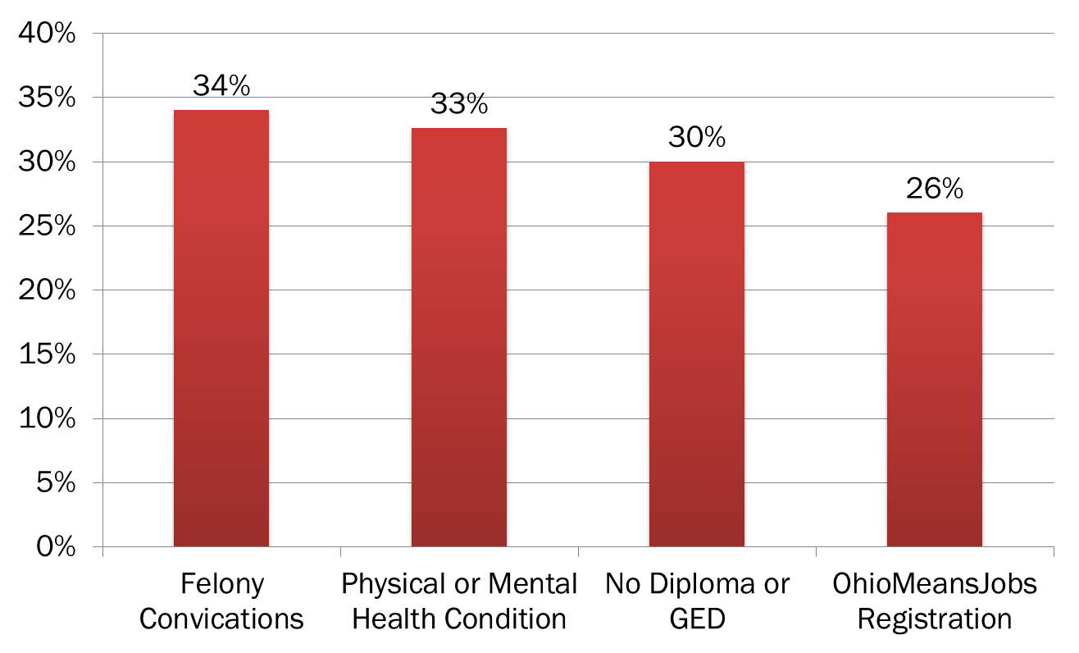
Percentage of ABAWDS with…

