Slide 1
Elizabeth Lower-Basch
Moving Beyond Work First
Creating a Framework for Work Programs that Simultaneously Promote Opportunity and Maintain a Safety Net
December 9, 2014

Slide 2
Safety Net
We need a safety net that has the reach and adequacy to ensure that all people can meet basic needs and progress toward economic security.
Human rights
Moral obligation/charity
Contrast with affluence
Child development
Business case
Universal risk

Slide 3
“Undeserving Poor”
“The folks next door who don’t do a lick of work but somehow keep getting government checks paid for by their tax dollar” – Kevin Drum
People are poor because of their own bad choices and lack of work ethic
Safety net only encourages “dependency” and further bad choices
“Dog whistle politics” – racial implications even when neutral language is used
Scant benefits, work requirements, time limits, etc.

Slide 4
Breaking Through the Stalemate
Safety Net
Undeserving Poor
Work Opportunities

Slide 5
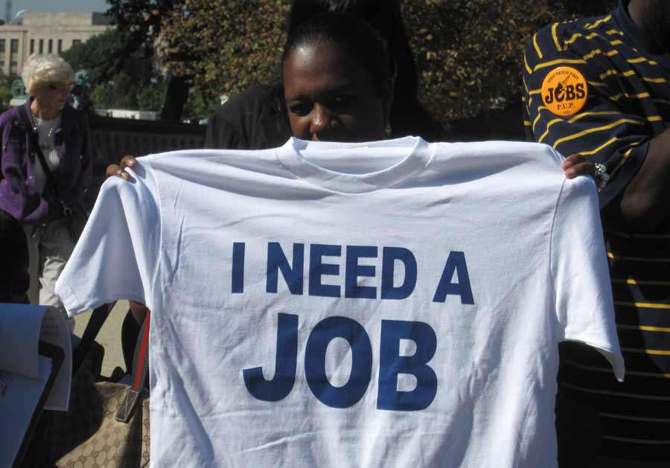

Slide 6
Work Opportunities
Everyone should contribute to the support of their families and to the broader community, through work when possible.
Most people want to do so but many are limited by economic conditions, low skills, logistical barriers or personal challenges.
Public benefit programs should offer work activities that contribute to participants’ economic security
Work requirements are only acceptable when designed so they promote economic security rather than hampering it.

Slide 7
Discussion
How might you use this framework to respond to a proposal to add work requirements to a program that does not currently have one?
How might you use this framework to resolve a disagreement among allies, such as in setting priorities for proposed legislation?
Comments, concerns, suggested changes?

