Slide 1

Talking Strategy:
Tools for Mounting Effective
Issue Campaigns
Louisa Warren
Senior Policy Advisor, CBPP
warren@cbpp.org

Slide 2


Slide 3


Slide 4


Slide 5

AGENDA
Why these strategy tools matter
Strategic assumptions, goals, & objectives
Powermapping to marshal your resources to the right places
Building strategic partnerships

Slide 6

Strategic Planning Overview
Strategic Assumptions
Objectives/Goals
Audience (Universe and Targets)
Message/Narrative
Strategy
Tactics
Timelines/Calendar
Budget

Slide 7
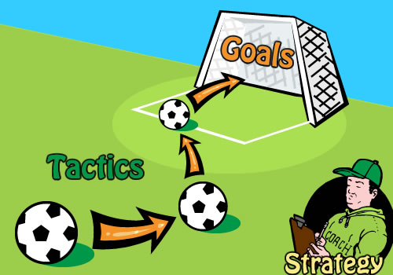
Goals, Strategies, & Tactics
Goals: Broad aim toward which your efforts are directed (what)
Strategy: Plan of action designed to achieve your goal (how)
Tactic: Specific action step required to delivery on a strategy

Slide 8

Powermapping = Targeting
Notes:
[LOUISA’S POWERMAPPING SECTION BEGINS]
Thanks Bailey! So, how many of you spend a lot of time asking the question, “who are our targets and why?”
Powermapping is an exercise is essentially a tool to answer those questions. It’s a tool that came out of the political organizing world and while typically used in the context of issue campaigns is also highly applicable to the work of analysts, comms, development, etc.

Slide 9

Getting to the Influencers
Notes:
Because…we’re all in the business of trying to INFLUENCE people and certain people at that. The act of powermapping helps us:
Define who the influencers are in the first place, i.e. naming the people who have power (whether it’s the right political power, resources/pursestrings, a powerful voice, etc)
Map out how to get to them
Target our resources wisely
In practice, powermapping can be done in a variety of ways—formally, informally, alone, with colleagues, with a coalition, with a different definition of influencer, etc. I’ll walk through a couple of the key elements of a powermapping process and how you can ponder using it in your work.

Slide 10
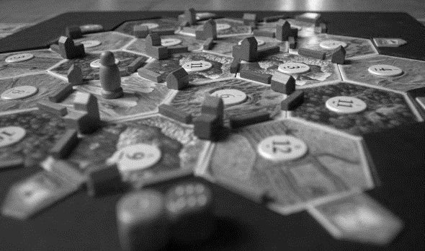
Powermapping Steps
Determine Strategic Assumptions & Goals
Determine the Targets/Influencers
Map the relational lines to Targets/Influencers
Target Priority Relationships
Connect to your campaign/strategy
Notes:
Here, in a nutshell are the broad steps of powermapping…
[after explaining steps]
Now we’re going to look at a few ways to organize a powermap. Many different models…

Slide 11
Elements of Powermapping
Decision Makers = The people/groups who actually make the decisions to change the problem/issue you’re addressing. Not the people who influence the Decision Makers.
Organized Allies = Individuals/groups who support your agenda.
Organized Opposition = Individuals/groups who actively oppose your agenda.
Core Constituencies = People directly affected by decisions but may not be organized on the issue.

Slide 12
Talking Strategy
Defining Targets
Primary Targets =
Decision Makers
Secondary Targets =
People who can get to Primary Targets

Slide 13
Talking Strategy

Slide 14
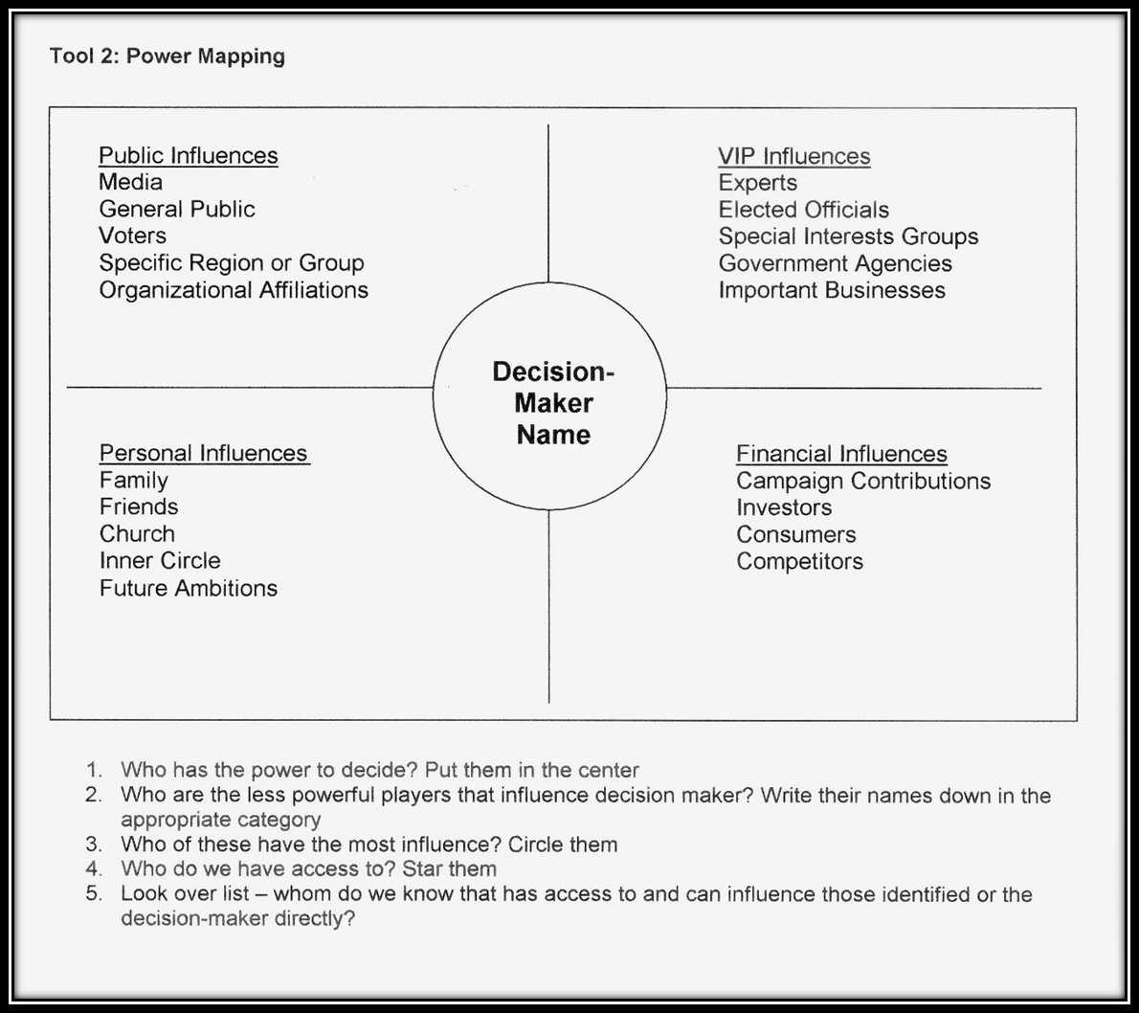
Talking Strategy

Slide 15

Talking Strategy
Cultivating Strategic Partnerships

