Slide 1
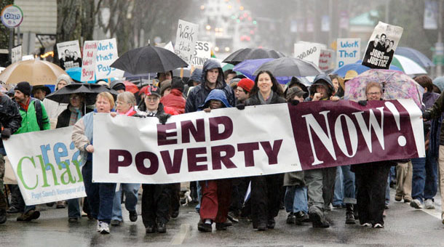
Moving Beyond Work First Getting the Message Right
Melissa Boteach
Vice President,
Poverty to Prosperity Program
Moving Beyond Work First Conference
Washington, DC
December 10, 2014

Slide 2
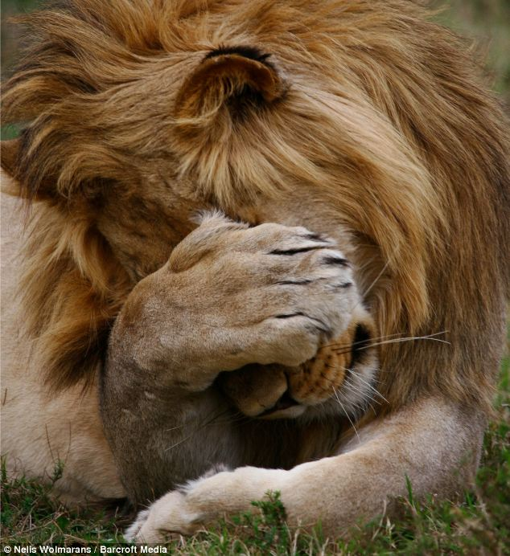
Tuesday, November 4

Slide 3
Key Takeaways
The JPB messaging framework project and how we got here
Beginning a new strategy together to push back on harmful policies while shifting the conversation to a proactive discussion about work
Your feedback on our framework and the specific examples shared during our panel

Slide 4
What happens if we only play defense

Slide 5
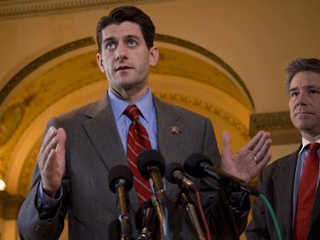
We let others define the impact of the policies we care about
“Next year marks the 50th
anniversary of the War on
Poverty. We’ve spent
approximately $15 trillion
and the question we ought
to be asking ourselves is,
‘where are we?’ With a 15
percent poverty rate today —
the highest in a generation —
and with 46 million people in
poverty, I would argue it’s not
working very well.”
– Rep. Paul Ryan

Slide 6
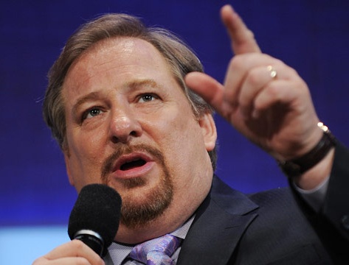
We let others define “opportunity.”
“When you subsidize people you create a dependency and rob them of dignity. Government should create opportunity and protect the country.”
– Pastor Rick Warren on ABC News

Slide 7
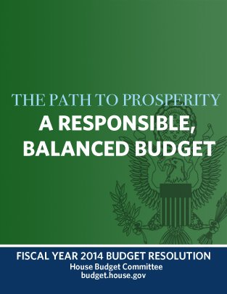
We let the wrong policy visions gain traction
“The welfare reforms of the 1990s, despite their success, were never extended beyond cash welfare to other means-tested programs. This budget completes the successful work of transforming welfare by reforming other areas of America’s safety net to ensure that welfare does not entrap able-bodied citizens into lives of complacency and dependency.”
- Report, House Budget Committee on FY2014 resolution

Slide 8
3 Reasons now is the time to pivot from defense to a proactive message

Slide 9
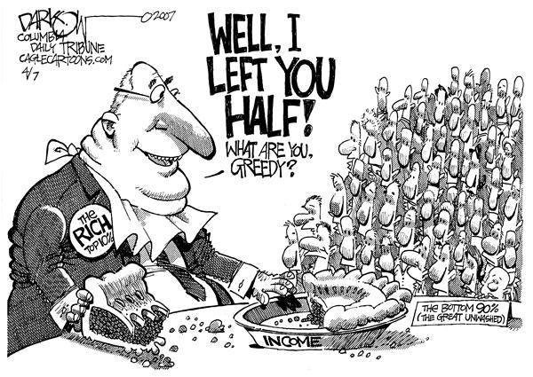
1. Convergence of Interests
The middle class increasingly recognizes income inequality and poverty as their problem too

Slide 10
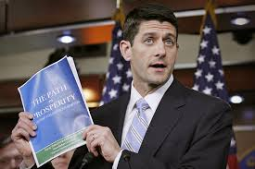
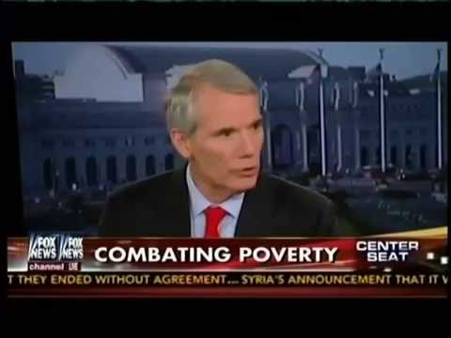
2. Policymakers are talking about it and building agendas around it

Slide 11
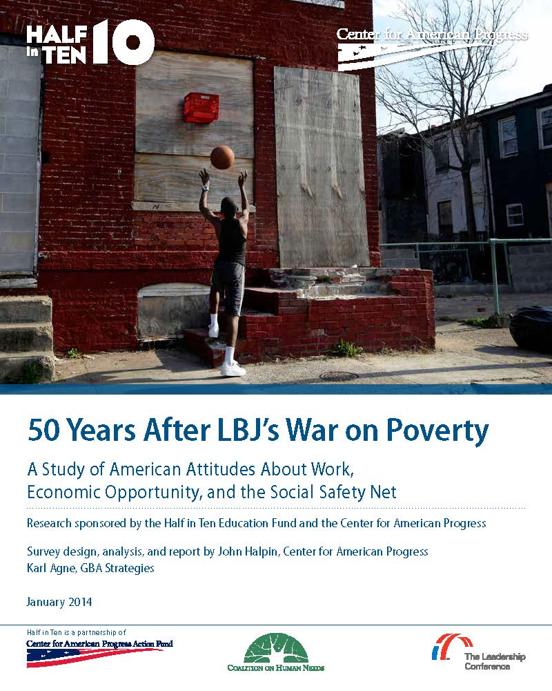
3. The public is ready for policy change
Our public opinion poll:
Fielded in November 2013
National survey of 1,000 adults
Oversamples of 3 critical constituencies: African Americans, Hispanics, and Millenials (18-34)
Notes:
Fielded in November 2013
National survey of 1,000 adults
Oversamples of 3 critical constituencies: African Americans, Hispanics, and Millenials (18-34)

Slide 12
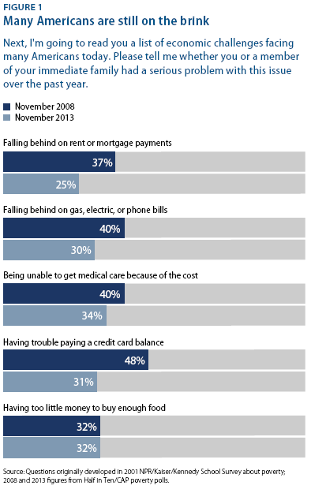
Many Americans are Still on the Brink
61% of American’s say their family’s income is falling behind the cost of living; only 8% felt they are getting ahead; 29% are staying even
25-34% of Americans report serious problems falling behind in rent, mortgage, or utilities payments, food, healthcare.
Notes:
61% of American’s say their family’s income is falling behind the cost of living; only 8% felt they are getting ahead; 29% are staying even
1/4 to 1/3 of Americans and even higher percentages of Millenials and people of color report serious problems falling behind in rent, mortgage, or utilities payments, food, healthcare.
While these have retreated over the years since the Great Recession, the numbers are still shockingly high, especially the disparities with other groups. Very uneven recovery

Slide 13
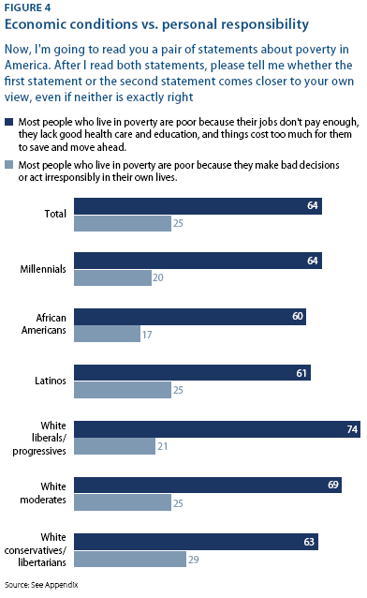
Most People are Poor Because of a Failed Economy
Nearly 2 in 3 Americans (64%) believe “Most people who live in poverty are poor because their jobs don’t pay enough, they lack good health care & education, and things cost too much to save and get ahead”
Notes:
In our survey we administered a forced choice test where 64% or respondents agreed that more people who live in poverty are poor because their jobs don’t pay enough, they lack good health care and education, and things cost too much for them to save and get ahead
In contrast, only 25% agreed with the position that people are in poverty because of bad decisions or personal irresponsibility

Slide 14
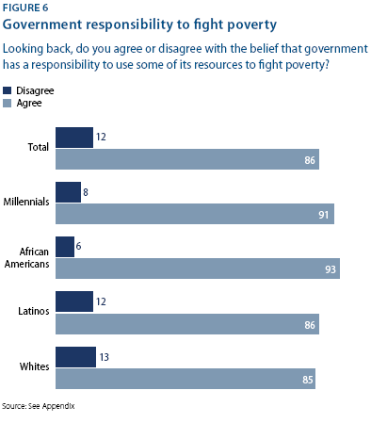
Strong Support for Govt Responsibility to Fight Poverty
86% agree that the govt has a responsibility to use some of its resources to combat poverty.
Notes:
But after being given additional context about the programs themselves and the goals for those programs and overwhelming 86% agreed that the government has a responsibility to use some of its resources to combat poverty
61% also agreed that the War on Poverty made a difference, although not a “major” difference
Heavily divided along ideological divides, which is no surprise
69% of white liberals and progressives believe the WOP worked
64% of white conserivatives believe the opposite

Slide 15
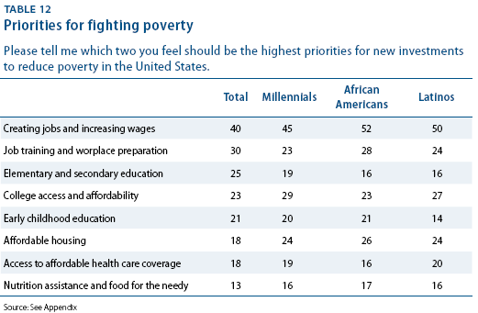
Clear Priorities to Cut Poverty: Jobs, Wages, and Education
Notes:
Asked which 2 areas they believe are most important for new investsments;
40% said creating jobs and boosting wages
30% chose job training and workplace preparation
25% chose elementary and secondary education;
23% chose college access and affordability
21% chose early childhood education

Slide 16
Similar support for messaging at the local level (Maine)

Slide 17
The JPB Communications Framework
As part of our joint project, CAP, CBPP, CLASP, and Georgetown collaborated on a new communications framework
Goal: to provide a diverse range of advocates across the country with a framework to help them push back on harmful narratives about poverty and deep poverty while pivoting to a proactive message about improving the structural economy, strengthening the safety net, and reducing barriers to employment

Slide 18
The JPB Communications Framework
Framework is built on the themes that test well based on existing communications research on poverty, opportunity and the economy
What it is NOT: a one-size-fits all set of talking points
What it IS: a flexible framework with a clear message that can be tailored to fit the natural voice of a wide range of institutions and messengers

Slide 19
Our three messaging pillars
By tearing down the barriers that keep people in poverty, we can ensure every American has the freedom to pursue their own happiness.
People who work for a living ought to have a decent life.
In America, every family should have good housing, nutrition, education, healthcare, and a secure retirement.
We shouldn’t trap people in poverty that often lasts or gets worse over generations.

Slide 20
Theme 1: People who work for a living ought to have a decent life.
Why?
There are too few jobs today and the many of the ones being created are set to deliberately deprive people of hours and wages sufficient for families to make ends meet. Many employers actually refuse to pay their low wage employees for every hour they're at work.
What should we do?
Pay Americans enough to take care of their families and provide their kids with good opportunities for the future. If you work full time, you should have a decent quality of life.
What’s wrong with the opposition?
We’ve tried denying people a decent salary and telling them to just work harder. It doesn't work. Cutting taxes for the wealthy and slashing public investment in the economy doesn’t create jobs. It just creates more unnecessary hardship for people and leaves an entire generation of young people without the skills and education necessary to drive the economy in the future.

Slide 21
Theme 2: In America, every family should have good housing, nutrition, education, healthcare, and a secure retirement.
Why?
There is a moral rationale for the safety net and an economic one. Both rest on the reality that people fall through the cracks through no fault of their own. Their jobs get eliminated or sent somewhere else; their wages get cut; they get sick or in an accident or need to care for someone who is sick or disabled; and they eventually get older and can’t work anymore.
What should we do?
We need public policies that are line with the realities of the 21st Century.
First, do no harm. Policy changes should not increase poverty or inequality in society.
What’s wrong with the opposition?
Conservatives have it all backwards. The governmental safety net doesn’t force people into poverty. Not having a job or getting low pay like the current minimum wage is what forces people into poverty. Losing your house or getting sick can force people into poverty.

Slide 22
Theme 3: We shouldn’t trap people in poverty that often lasts or gets worse over generations.
Why?
Everyone deserves a fair shot to succeed, but people often miss or overlook the artificial barriers that keep people stuck in poverty.
What should we do?
We should stop putting so many people in jail for low-level drug offenses and remove barriers to employment, housing, education, credit, and the safety net for those who have served their time and are trying to rebuild their lives.
What’s wrong with the opposition?
Pulling yourself up by the bootstraps is the quintessential American story. But it only works if there isn’t some rigging the game against you and if you have a fair starting point.

Slide 23
Let’s discuss!
Given the policy movements you encounter at the state and local level, what are some of the opportunities to pivot from a defensive to a proactive message?
Does this framework fit the variety of challenges and issues you face in your work?
Even when you lose or don’t make the progress you want to, why does having an alternative message and “pivot” matter?
What kind of tools and resources do you find most helpful in developing your “pivot points”?
How do some of these examples of proactive messaging fit into a national narrative for broader policy change given that major policy shifts are taking place locally?

Slide 24
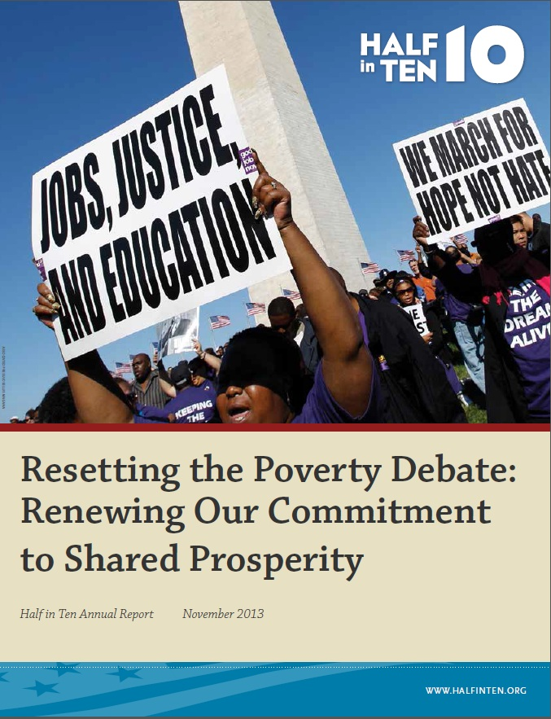
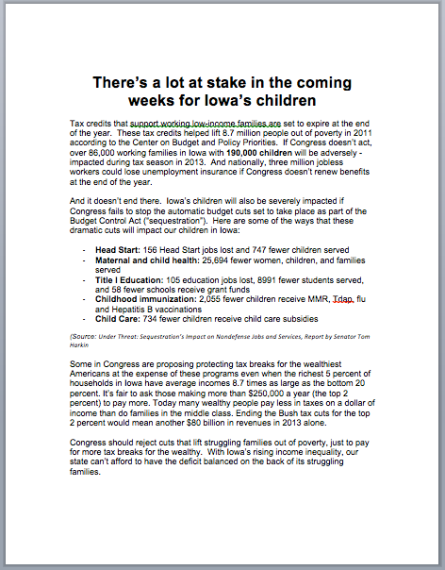
Half in Ten Action Resources
Communications training and technical assistance
Data tools and resources

Slide 25
Thank You and stay in touch!
www.TalkPoverty.org
mboteach@americanprogress.org
@TalkPoverty
@mboteach
@HalfinTen

