Slide 1
The SNAP 3-Month Time Limit Returns in Force CY2016
CBPP estimates that roughly 1 million individuals will lose SNAP eligibility in 2016 as a result of the time limit.
This group receives approximately $150 to $200m per month in benefits.

Slide 2
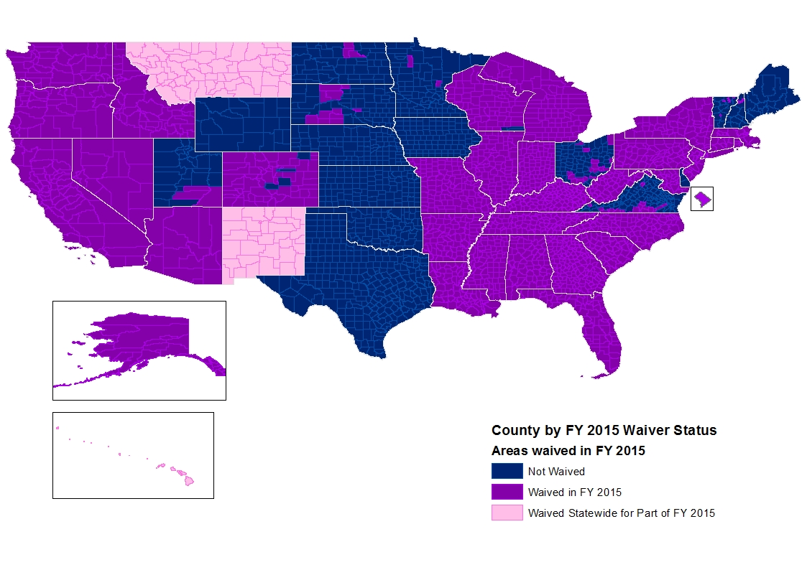
About 70% of the Country Lives
in a Waived Area in FY15
Notes: Wisconsin will begin implementing the time limit statewide in January 2015. This does not include eligible reservations.

Slide 3
But, Only about 20% of the Population Will Live in Waived Areas in 2016
This projection is based on recent state behavior and unemployment rates.
Notes:
This map shows the impact of state behavior, i.e. TX and OK have dropped their waivers so we assume that they won’t seek them in 2016. WI and NM have said that they will drop, etc. And, in this map we estimate that CA, IL, NV and RI lose state wide waiver state
CBPP estimates that about 1 million ABAWDs will lose eligibility in 2016. That’s a loss of some $150m to $200m per month in benefits to this vulnerable population.
Historically about 30% of the population lived in waived areas.

