Slide 1
Overview of SNAP Employment & Training
Ed Bolen
Senior Policy Analyst
Center on Budget and Policy Priorities
November 2014
Notes:
Welcome to this webinar on SNAP E&T.
Let’s start with what I hope you already know. SNAP = food stamps, nation’s primary response against hunger.
46.5m individuals, Is a countercyclical part of the safety net -- participation grew in response to recession.
It’s an entitlement – if meet eligibility requirements (and maintain eligibility) then receive benefits.
What you may not know – and we’re here to talk about – is SNAP has work requirements and an E&T program

Slide 2
Why SNAP E&T is Important
Congress, other stakeholders and the media are examining SNAP’s relationship to work.
States are interested in improving E&T activities.
The choices states make can put a household’s benefits and food security at risk.
Nondisabled childless unemployed adults may be at risk of losing benefits.

Slide 3
SNAP work requirements
SNAP participants must register for work unless they are:
Under 16 or over 59 years old;
Physically or mentally unfit for employment;
Caring for dependent child under 6 or incapacitated person;
Complying with work requirements in another program;
Receiving Unemployment;
In a drug or alcohol treatment and rehabilitation program;
Working 30 hours a week;
A student enrolled at least half time.
Notes:
SNAP has work requirements for most adults able to work.
Work registrants must accept a job if offered one by state, not voluntarily quit a job without good cause, provide information to state if required and participate in E&T if assigned by state.

Slide 4
SNAP E&T in the States
State SNAP agencies generally use E&T in three basic ways:
To test an individual’s willingness to work
To provide unemployed childless adults with a way to keep food benefits
To improve an individual’s skills and work experience
Programs can be mandatory or voluntary
Notes:
Willingness to work – mandatory job search, workfare, work experience
ABAWDs – could be mandatory or voluntary. Can’t be job search
Improving skills tends to be intensive training or education – expensive and limited.
Again, a mandatory E&T requirement can put an individual’s food benefits at risk

Slide 5
Allowable Activities in E&T
Source: 2011 data from USDA, Food and Nutrition Services
Activity | Participants (in 000s) | Percent
Job search | 698 | 55
Job search training | 88 | 7
Workfare | 139 | 11
Work experience | 105 | 9
Education (Adult Basic Ed, GED, ESL, higher education) | 35 | 3
Training (on-the-job, vocational) | 50 | 4
Workforce Investment Act programs | 16 | 1
Job retention up to 90 days | 9 | 1
Total | 1269
Notes:
A wide variety of activities can be offered through SNAP E&T. As you can see, most states focus on relatively inexpensive low-touch activities like job search and workfare.
Can be run by the state, contracted out to other gov’t entities, nonprofits, community colleges, etc.
- ex. UT runs a job search program in conjunction with it’s UI job search
Many states contract w community colleges in certain areas
WA has an impressive network of providers

Slide 6
SNAP E&T
Work registrants can, but do not have to, be assigned by the state to an E&T activity
States can exempt additional individuals
Programs can be mandatory or voluntary
If the state assigns an individual to an activity:
The state must determine the appropriate activity
The state must reimburse for an individual’s expenses that are reasonable and necessary to participate
Individuals in mandatory programs can lose benefits for failure to comply
Notes:
States have enormous flexibility with regards to their E&T programs – and so, E&T can look very different state-to-state, in both who is served, how they are engaged and what kinds of activities they may do.
States can decide to who to assign to a work requirement. The state can exempt additional categories of participants, individuals in certain areas or certain individuals.
A state can not assign anyone, but can make E&T programs available to anyone who wants to participate – these are voluntary programs. In 2013, 29 states have voluntary-only programs.
States decide which activities to offer, and often have a mix – job search for many work registrants and a few intensive training programs in certain areas.
Assessment is required, but not clear how effective states are.
Reimbursements typically for transportation, child care. Can be capped by state – if participant’s costs exceed the reimbursement level, then individual doesn’t have to participate

Slide 7
SNAP E&T and Benefits
If E&T is voluntary and individual fails to comply:
Must continue to meet work registrant requirements
Does not affect SNAP benefits
If E&T is mandatory, and individual fails to comply:
Can lose benefits for specified time
Whole household can be sanctioned (state option)
Notes:
E&T is embedded within a nutrition program
Critical to understand that failure to participate in E&T can result in loss of food assistance.

Slide 8
Federal SNAP E&T Funding: FY 2012
Type of funding | Amount (in millions)
100% federal | 90
50% reimbursements | 240
Administration and services | 182
Dependent care | 27
Transportation | 31
ABAWD Pledge states | 20
Supplemental allocation | 12
Total federal funding | 362
Notes:
Several types of federal funding.
50% reimbursements are not capped. These funds can expand the number of slots provided.
Pledge states promise to offer every ABAWD an opportunity to do 20 hours of job training (typically workfare or community service). Workfare hours determined by dividing value of benefit by minimum wage.
SNAP E&T can operate like a funding stream at local level – job training program may get funds from multiple sources and, if serving SNAP participants, can get federal funds.

Slide 9
Beware The Time Limit for Nondisabled Childless Adults
Unemployed childless adults can receive benefits for only 3 months in a 3 year period.
Unless they work or participate in work activity for 20 hours a week.
This requirement was largely waived during the recession
Some states focus E&T on this population, just to keep them eligible.
Notes:
Since 1996 welfare reform, SNAP is a time limited benefit for ABAWDs who can’t find work or training.

Slide 10
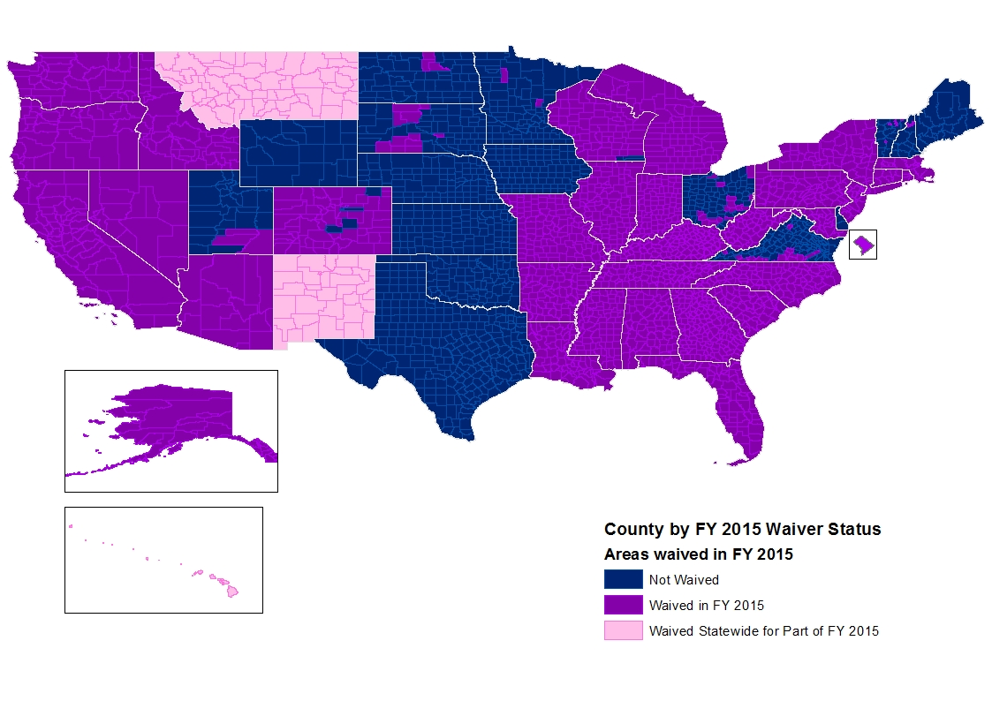
About 70% of the Country Lives in a Waived Area in FY15
Notes: This does not include eligible reservations. Wisconsin will begin implementing the time limit statewide in January 2015.

Slide 11
But, only about 20% of the Population Will Live in Waived Areas in 2016
This projection is based on recent state behavior and unemployment rates.
Notes:
This map shows the impact of state behavior, i.e. TX and OK have dropped their waivers so we assume that they won’t seek them in 2016. WI and NM have said that they will drop, etc. And, in this map we estimate that CA, IL, NV and RI lose state wide waiver state
CBPP estimates that about 1 million ABAWDs will lose eligibility in 2016. That’s a loss of some $150m to $200m per month in benefits to this vulnerable population.
Historically about 30% of the population lived in waived areas.

Slide 12
Issues for nondisabled childless adults
Waivers:
What areas can a state still waive?
State flexibility:
Who is and is not subject to ABAWD requirements?
Who will the state individually exempt?
Who will be offered qualified training (and what activities qualify)?
Notes:
Remember the overarching questions:
What is the state’s goal?
What type of activities will help individuals achieve the goal?
How does the state identify who will participate?
How does the state monitor progress towards the goal?
What does the state do with its monitoring information?

Slide 13
What works in SNAP E&T?
We don’t know!

Slide 14
SNAP Pilots
Goal: to test new methods for E&T programs and services to increase employment and earnings and reduce reliance on public benefits.
Up to 10 pilot projects with a rigorous independent evaluation
$200m in funding: $165m for operation, $35m for evaluation
Diverse range of pilots will be selected
Rural/urban, mandatory/voluntary, serving childless adults
Proposals are due Nov. 24, 2014; FNS will select pilots by Feb. 23, 2015
Notes:
Target low skills/limited work, workfare, and individuals who are working
Geographically diverse
Include education and training, rehabilitative services, rapid attachment to work, and mixed strategies
Mandatory and voluntary

Slide 15
Permissible pilot activities
All SNAP E&T activities, including Title 20 workfare and job retention
Substance abuse and mental health treatment, rehabilitation services
Subsidized work in the public or private sector
Unsubsidized work
E&T funds pay for supportive services like child care

Slide 16
Elements of Effective SNAP E&T Pilots
Assessment: Careful attention to targeting
How does the state determine which E&T services are the most appropriate based on an individual’s circumstances and needs?
For voluntary approaches, how does the state identify recipients who are interested in training and have the greatest chances of success?
Collaboration with workforce development
Evidential link between proposed activities and desired outcomes
Is there research or a track record of success using the proposed approach?
Notes:
SNAP caseload is very diverse. Diverse needs require diverse solutions

Slide 17
Engaging Your State
What is the state’s goal?
What type of activities will help individuals achieve the goal?
How does the state identify who will participate?
How does the state monitor progress towards the goal?
What does the state do with its monitoring information?
Notes:
What role does compulsory/mandatory activities play in the state’s goals? Who is subject to mandatory,

Slide 18
Resources
SNAP Work Rules: 7 C.F.R 273.
(http://www.ecfr.gov/cgi-bin/text-idx?c=ecfr&sid=4bf29bea0133bb56d4571286fa470ad2&rgn=div8&view=text&node=7:4.1.1.3.21.3.1.3&idno=7)
ABAWD Rules: 7 C.F.R. 273.24
(http://www.ecfr.gov/cgi-bin/text-idx?c=ecfr&sid=4bf29bea0133bb56d4571286fa470ad2&rgn=div8&view=text&node=7:4.1.1.3.21.7.1.5&idno=7)
SNAP Pilot in law: 7 U.S.C. 2025(h)(F)
SNAP Pilot resources: http://www.fns.usda.gov/2014-snap-e-t-pilots

Slide 19
Resources
FNS E&T Resource Center: http://www.fns.usda.gov/employment-and-training-et-resource-center
Resources to improve work programs: www.buildingbetterprograms.org
National Skills Coalition SNAP E&T Users Guide: http://www.nationalskillscoalition.org/assets/reports-/snapet_users_guide.pdf
CLASP: http://www.clasp.org/issues/basic-skills-and-workforce-training

