Slide 1
Federal Rental Assistance Programs and Work
Barbara Sard
Center on Budget and Policy Priorities
November 14, 2014

Slide 2
Agenda
Background on Federal Rental Assistance
Work-related policies and funding opportunities in major rental assistance programs
Why partner with housing agencies to promote work?

Slide 3
Background on federal rental assistance

Slide 4
5 Million Households Receive
Federal Rental Assistance
Federal Rental Assistance, by Type
3
Notes:
“RA” means means-tested eligibility and amount of assistance. Typically, tenant rent contributions based on 30% of income. Specify HCV often called “section 8”

Slide 6
Large Majority of Non-Elderly, Non-Disabled
HUD-Assisted Households Work or Likely Subject
To Work Requirements in 2010

Slide 7
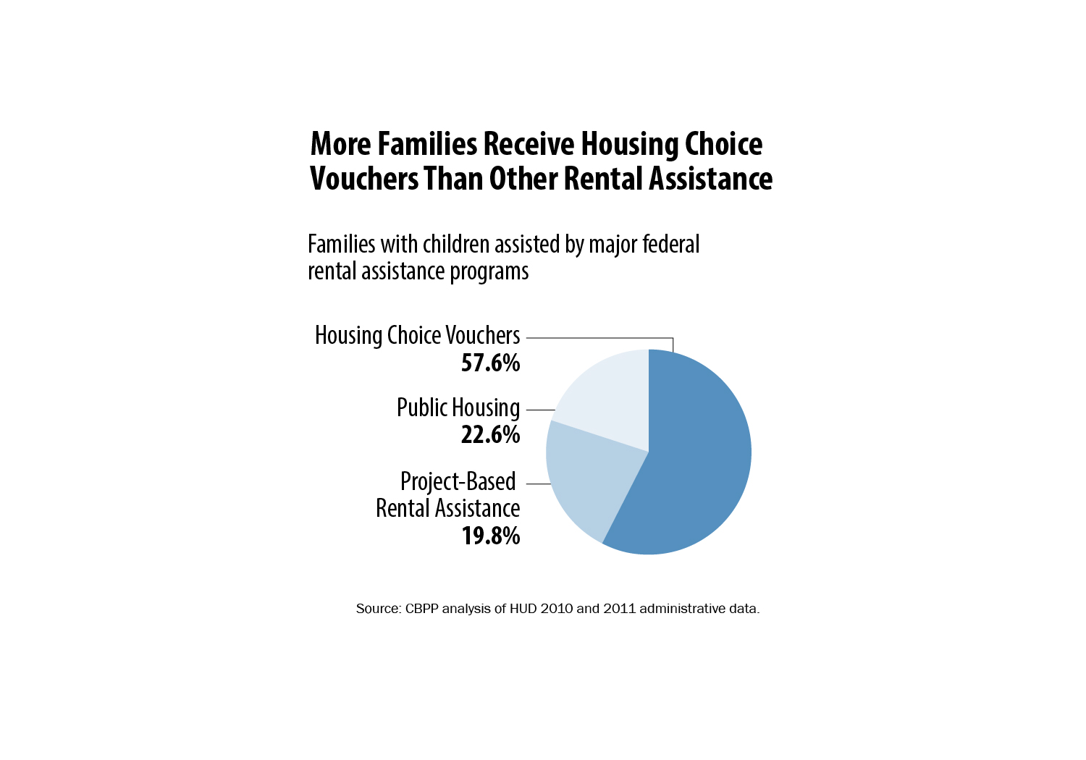
More Families Receive Housing Choice Vouchers Than Other Rental Assistance

Slide 8
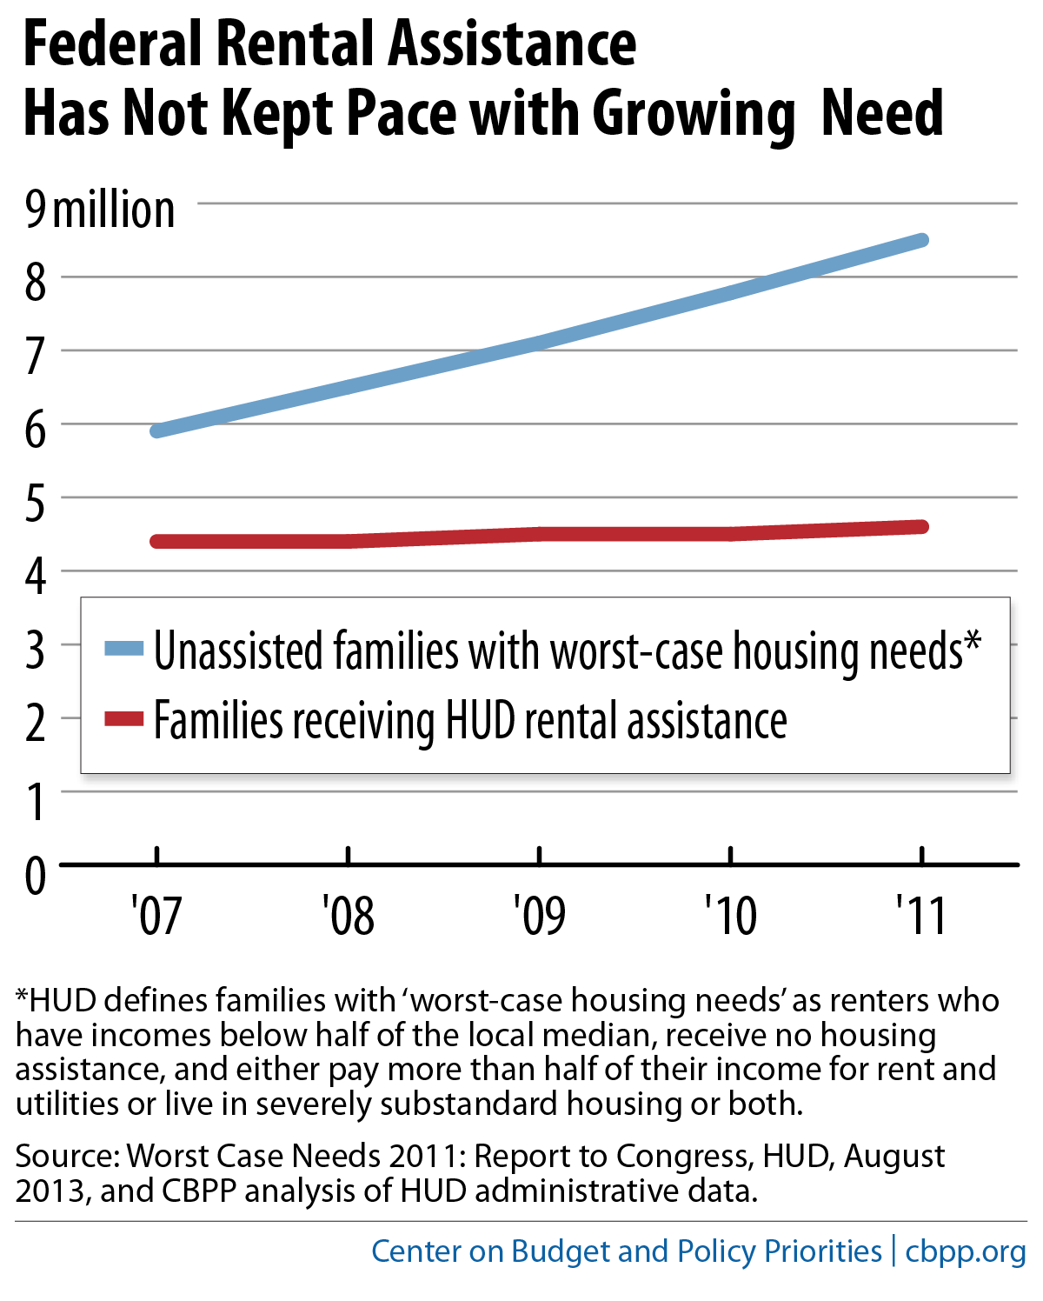

Slide 9
Work-related policies

Slide 10
Overview of Work Policies
Generally, no work requirements are allowed by federal law, for admission or continued occupancy.
Working preferences are permitted for admission (if equal preference for elderly and disabled); discretion on definition of “work”
  Public housing agency or assisted owner may have admissions preference for households enrolled in particular training programs; tool to leverage services.

Slide 11
Overview of Work Policies - 2
Adult public housing tenants who are not “engaged in work activities” (state TANF definition or working 30 hours/week) or otherwise exempt are subject to “community service” requirement
  Can be met by education/training; substance abuse or mental health counseling; volunteer activities (e.g., at kids’ school or with tenant organization)
    See HUD, Public Housing Occupancy Guidebook, ch. 15.
  Federal policy requires 8 hours per month; HUD has allowed more stringent local policies
  Non-compliance grounds for eviction
Notes:
If state TANF agency deems individual to be engaged in work activities, OR not in non-compliance w. work requirements, individual is exempt
HUD guidance has broadened the regulatory definition – CHECK
- Enforcement of CS spotty; upcoming HUD rules may allow self-certification

Slide 12
Moving to Work Demonstration
39 public housing agencies allowed broad flexibility, including imposition of stringent work requirements and/or time limits.
Some agencies apply work requirements to all non-elderly, non-disabled tenants (typically may be met, at least in part, by education/training).
  Some have indirect policies, such as “stepped” rents based on duration of assistance.
  Others have limited or no work requirements.

Slide 13
Work-Related Rent Policies
Child Care
  In determining tenants’ required rent payment, unreimbursed “reasonable” expenses for care of children under 13 necessary to seek or retain employment or participate in education must be deducted from income.
  In effect = 30% subsidy for child care costs.
  Take-up rate surprisingly low.
PHAs may permit up to one year delay in rent increase when income increases
Public housing earnings disregard for 24 months

Slide 14
“Section 3” Hiring and Training Requirements
30% of new hires and training program enrollees supported by federal housing and community development funds should be low-income households, particularly public housing residents
HUD enforcement improving, but weak
Some PHAs have effective programs, usually as result of local advocacy

Slide 15
HUD Work-related programs and grants

Slide 16
Family Self-Sufficiency Program
Case management + savings model, usually 5 years, to promote employment, increased earnings, and exit from TANF
Housing Choice Voucher and public housing tenants eligible
  FY2015 appropriation bill may extend eligibility to PBRA tenants (privately-owned properties)
~1,200 PHAs offer FSS; program size usually limited by staff capacity
  About 70,000 families now participate

Slide 17
FSS - 2
Increased rent payments due to earnings put in escrow savings account
  Families may be able to draw on savings during program for tuition, car repairs, etc.
  Savings belong to graduating families (successfully complete plan and off TANF for 12 months)
PHAs can expand FSS programs if can support case management costs
  federal administrative $ limited, but not savings

Slide 18
FSS - 3
Encouraging findings on program results for those who graduate: average income increased from $19,902 to $33,390.
Random assignment study in NY found significant positive impacts for those not working at entry and SNAP recipients
Larger rigorous study underway
Notes:
New HUD Secretary may prioritize improvement, expansion of FSS

Slide 19
HUD Grant Programs - Jobs-Plus
Jobs-Plus Pilot to increase earnings of public housing residents
$24M; 8 grants expected (4-year); applications due Dec. 17, 2014
  More funding may be available in 2015
Emphasizes career pathways in local labor market, employer-based training, partnerships (required with local WIB or American Job Center), “community coaches” and financial incentives (all increased earnings disregarded)

Slide 20
HUD Grant Programs - ROSS
Resident Opportunities for Supportive Services (ROSS) Service Coordinators Program
For residents of public or Indian housing
3-year grants for PHAs, tribal housing entities, resident associations or non-profits
Can focus on families – to increase earnings – or elderly/disabled
Cannot fund direct services
FY14: $36M for 3-year grants, 25% match required
Notes:
Applications were due 8/18/14; maximum eligibility dependent on # of occupied units

Slide 21
Why Partner with Housing Agencies?
Housing as “platform”
  Evidence that welfare-to-work demonstrations resulted in greater success for assisted housing tenants
  Assisted properties can—
    Yield economies of scale for providers
    Offer free/low-cost space for training, child care
      Evidence of higher participation in on-site services
    Encourage work through “saturation” model (Jobs-Plus)

Slide 22
Why Partner with Housing Agencies - 2
Reach families not receiving TANF
  Time-limited or otherwise not able to participate, with little or no income
  Still poor, but incomes above TANF level
    Housing providers interested in work-related programs likely to aim to increase incomes enough to afford unassisted housing

Slide 23
MTW Agencies
Alaska Housing Finance Corporation
Atlanta Housing Authority
Baltimore City Housing Authority
Boulder Housing Partners
Cambridge Housing Authority
Champaign County Housing Authority
Charlotte Housing Authority
Chicago Housing Authority
Columbus, Georgia Housing Authority
Delaware State Housing Authority
District of Columbia Housing Authority
Fairfax County Redevelopment and Housing Authority
Holyoke (MA) Housing Authority
Keene (NH) Housing Authority
King County Housing Authority
Lawrence-Douglas County Housing Authority (KS)
Lexington-Fayette Urban County Housing Authority (KY)
Lincoln Housing Authority (NE)
Louisville Metropolitan Housing Authority
Massachusetts Dept. of Housing and Community Development
Minneapolis Public Housing Authority
New Haven City Housing Authority
Oakland Housing Authority
Orlando Housing Authority
Philadelphia Housing Authority
Pittsburgh Housing Authority

Slide 24
MTW Agencies - 2
Portage Metropolitan Housing Authority (OH)
Portland Housing Authority (OR)
Reno Housing Authority
San Antonio Housing Authority
San Bernardino County Housing Authority
San Diego Housing Authority
San Mateo County Housing Authority
Santa Clara County Housing Authority/San Jose City Housing Authority
Seattle Housing Authority
Tacoma Housing Authority
Tulare County Housing Authority
Vancouver Housing Authority

Slide 25
Additional Resources
:
CBPP Policy Basics on Federal Rental Assistance: http://www.cbpp.org/files/PolicyBasics-housing-1-25-13RA.pdf
Barbara Sard, “Most Rental Assistance Recipients Work, Are Elderly, or Have Disabilities,” July 2013, http://www.cbpp.org/cms/?fa=view&id=3992
Will Fischer, “’Moving to Work’ Compromise Would Reduce Risk from Expanding Demonstration,” June 2013, http://www.cbpp.org/cms/?fa=view&id=3981
Barbara Sard, “The Family Self-Sufficiency Program: HUD’s Best Kept Secret for Promoting Employment and Asset Growth,” Center on Budget and Policy Priorities, April 2001, http://www.cbpp.org/cms/?fa=view&id=174.
Hannah Emple, “Asset-Oriented Rental Assistance: Next Generation Reforms for HUD’s Family Self-Sufficiency Program,” New American Foundation, December 2013, http://assets.newamerica.net/sites/newamerica.net/files/policydocs/EmpleFSS12.5.13.pdf
Barbara Sard and Micah Kubic, “Reforming HUD’s ‘Section 3’ Requirements Can Leverage Federal Investments in Housing to Expand Economic Opportunity,” June 2009, http://www.cbpp.org/cms/index.cfm?fa=view&id=2837
Barbara Sard and Amy S. Bogdon, eds. A Place to Live, a Means to Work: How Housing Assistance Can Strengthen Welfare Policy, Fannie Mae Foundation 2003 (available on request from Barbara Sard)

Slide 26
Additional Resources - 2
Jobs Plus Pilot NOFA: http://portal.hud.gov/hudportal/documents/huddoc?id=2014jppnofa.pdf
James A. Riccio, “Sustained Earnings Gains for Residents in a Public Housing Jobs-Program, Seven-Year Findings from the Jobs-Plus Demonstration,” MDRC, 2010, http://www.mdrc.org/sites/default/files/policybrief_33.pdf.
James Riccio, “Subsidized Housing and Employment,” MDRC, 2007, http://www.mdrc.org/sites/default/files/full_521.pdf . (Table 1 summarizes the results of 10 different analyses, 8 of which show larger and statistically significant earnings effects for welfare recipients who were receiving some form of housing assistance.)

