Slide 1
Applying a Rapid-Cycle Learning
Approach to Accelerate Progress in
Employment and Related Programs
COREY ZIMMERMAN
Senior Project Manager, Frontiers of Innovation Initiative
Center on the Developing Child at Harvard University
Building Better Programs Webinar
June 17, 2015
Notes:
Welcome and thank you for having me today. I’m Corey Zimmerman, Senior Project Manager at the Center on the Developing Child at Harvard University.

Slide 2
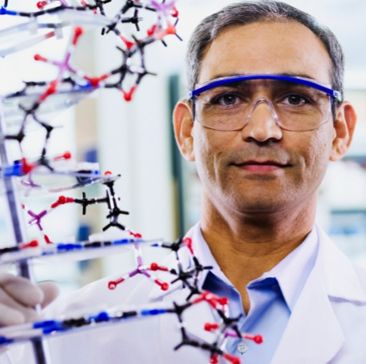
Our Mission
To drive science-based innovation
that achieves breakthrough outcomes
for children facing adversity
Our Work
The Center’s work focuses on two objectives:
Building an R&D platform that leverages science to catalyze the design, testing, and scaling of new intervention strategies
Transforming the policy, practice, and research landscape to support and drive change
Notes:
So first off, who is the Center on the Developing Child?
The Center was established in 2006. It started with a mission to generate, translate, and apply scientific knowledge in the service of closing the gap between what we know and what we do to improve life outcomes for children living in adverse circumstances.
Our initial strategy was to use existing knowledge about early childhood development to educate policymakers and build broad-based support for effective programs. In that vein, we have the National Scientific Council on the Developing Child. We have a set of scientific working papers on topics from the foundations of resilience to workforce development, welfare reform and child well-being.
Over time, as the message about the importance of investing in the early years took hold, we became increasingly struck by the limits of state-of-the-art programs and turned to science as a source of new ideas.
We now view current best practices as a starting point, not a solution, and our mission is to drive science-based innovation that achieves breakthrough outcomes for children facing adversity.
Our work then is focused on two main objectives:
1) Building a research and development platform to foster and support the development of new intervention strategies, and
2) Transforming the policy, practice and research landscape to support and drive change.

Slide 3
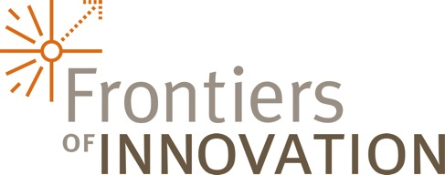
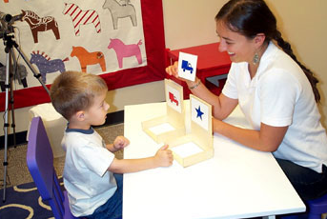
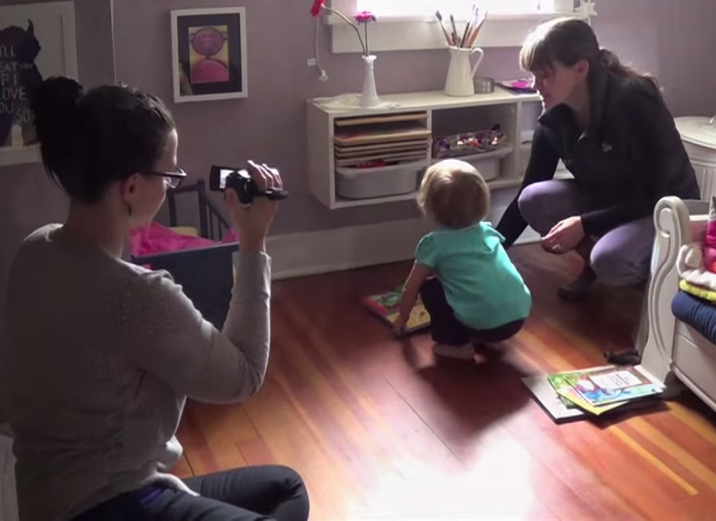
A network of practitioners, researchers, and policymakers committed to using the science to design, implement, and evaluate innovative practice models through a range of on-the-ground projects
Notes:
I work on the team that is called Frontiers of Innovation.
In short, within the Center there is a team who works with researchers to translate the science and generate the related working papers. Then there is a group of us who works on figuring out so now that you know that, how and what could you do
FOI is the network of practitioners, researchers and policymakers who are committed to using the science to design, implement, and evaluate innovative practice models through a range of on-the-ground projects.
3

Slide 4
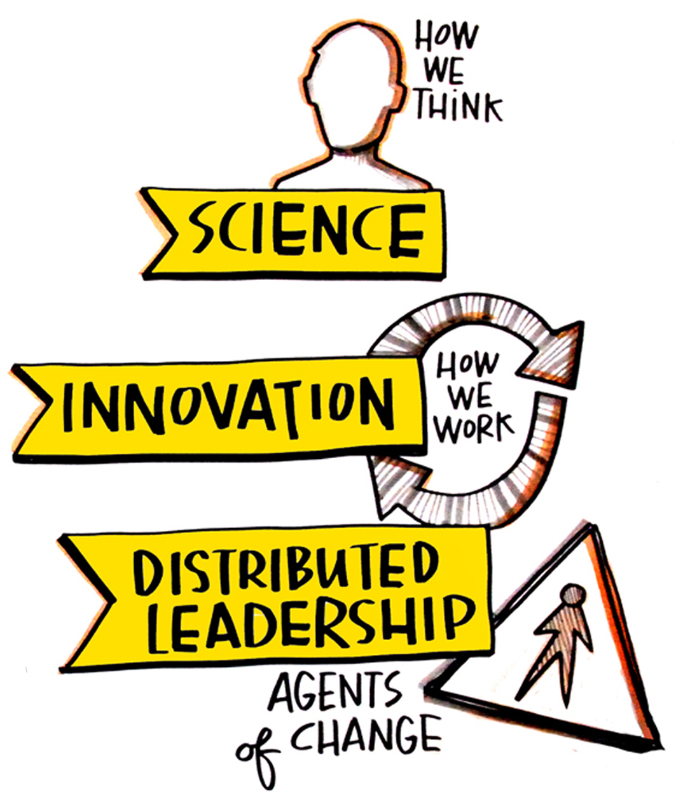
Today’s Overview
Notes:
Today I’m going to talk about 3 things:
Science as a new way of thinking
Innovation as a new way of working
And third distributed leadership.
We’ll plan to have time at the end for questions.
4

Slide 5
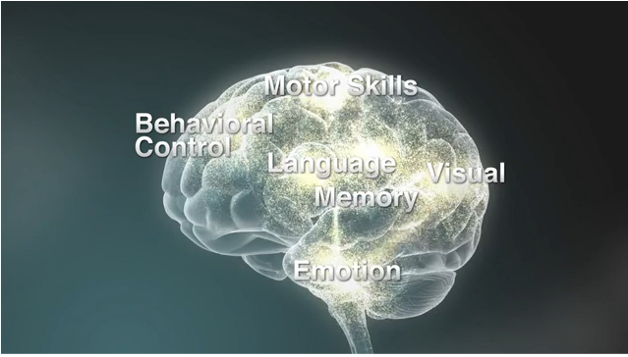
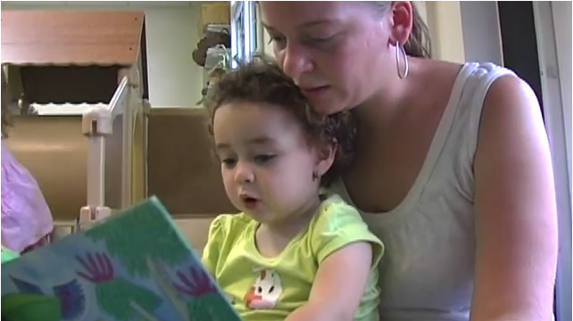
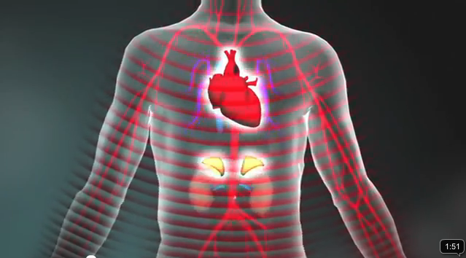
Three Core Concepts of Development
Brain architecture is established early in life and supports lifelong learning, behavior, and health
Stable, caring relationships and “serve and return” interaction shape brain architecture
Toxic stress in the early years of life can derail healthy development
Notes:
So I'm going to start by talking about the science, as for us, this is the inspiration for why we believe there are new and better ways to reach breakthrough outcomes for children and families. Let me acknowledge that I am going to start telling this story from a point in early childhood, but stick with me, I am quickly going to get to what's happening with adults.
Also, I want to say that I think understanding how the brain develops is relevant if you working with children or adults, as it helps to understand the client or participant in front of you.
Over the past several decades there has been an explosion in neuroscience and other fields, about what we now know about how the brain works; how it develops; and how it develops over time. Yet there are many reasons, why this knowledge has yet to reach and impact how we provide so many social services.
So there are three core concepts of human development that are useful to know and understand.
So the first concept - is that it all begins with building brains. The architecture of the human brain is constructed through an ongoing process that begins at birth. Think of it like building a home. There is a sequence. Just as the building of a home follows a sequence (foundation, framing, wiring…) building a strong foundation in the brain early in life affects everything that comes later. A strong foundation early on increases the likelihood of positive life outcomes.
So then, how do brains get built? Brain architecture is built and shaped by early experiences. Just like a game of tennis or volleyball, there is a back and forth between young children and their parents, caregivers and community that “wires” their brains. If babies and children reach out and are consistently not responded to, the process is incomplete and there are negative implications for later learning.
What disrupts the development of healthy brain architecture? “Toxic Stress” disrupts the development of brain architecture. Stress is a hormone that our body emits in response to well, stressful, situations.
Some stress is ok in the developing body. A toddler can't have the cookie she wants. While this is quite stressful in the moment, if there is an available caregiver who can respond and help calm the toddler down, this can become positive stress. Out of this experience the toddler learns some about emotions, and begins to work on developing self-regulation related to those emotions.
At the next level though, there are stressful events that are quite serious, all the way up to the loss of a parent, but if there again an available caregiver who can support the child through their emotions and responses to the situation this can become what’s called tolerable stress.
The threshold for when stress begins to become toxic is when young children experience chronic, stressful conditions in early development such as extreme poverty, abuse or maternal depression. The three critical components here of crossing into toxic stress are that the situation is chronic, its prompting the child's fight or flight response, our natural reaction to stress, and that there is no available adult caregiver to regularly help calm the child down.
When the developing brain always has its fight or flight system turned on, it literally starts to rewire itself. It becomes more easily triggered by certain things, it effects how new situations are perceived, what is noticed in situations. In short, being in a toxic stress situation can lead to lifelong difficulties in learning, memory and self regulation and lead to chronic health conditions. The brain’s response to toxic stress never goes away, with costly consequences for both children and society.
So knowing this, part of the response is to say we need to intervene early in children's lives, because what happens then sets a foundation for a lifetime of learning and health.

Slide 6
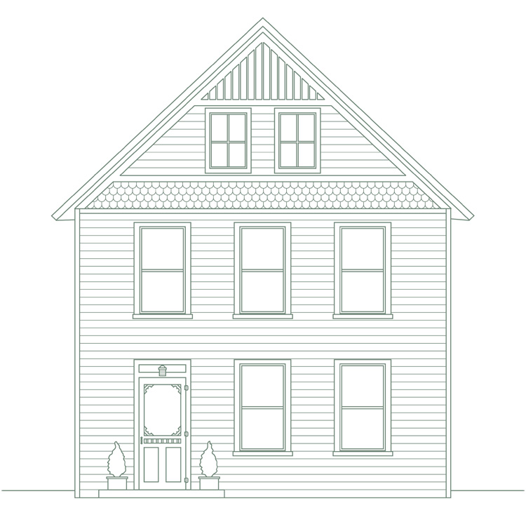
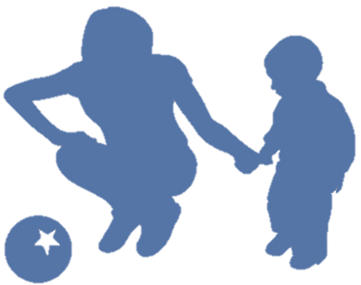
Science-Based Strategies
Achieving breakthrough outcomes for children facing adversity requires transforming the lives of the adults who care for them.
1
Adults need a set of core skills to provide protection and enrichment to children.
2
Building those skills enhances employability and economic stability
3
Strong neighborhoods reduce the burdens of adversity
Notes:
Based on this science, it becomes clear that:
- The adults need a set of core skills to provide protection and enrichment to children.
- Interestingly, it turns out at the root, that by focusing on adults' capacities, the skills needed to be a capable parent turn out to be very similar to the skills needed to be a productive and successful member of the workforce.
- Third, children grow up within communities, and communities have a huge role to play in protecting them and in supporting the adults whom they rely upon.
In short achieving breakthrough outcomes…
So now this is where my world, starts to overlap with yours and Donna’s.

Slide 7
Building Adult Capabilities to Improve
Child Outcomes: A Theory of Change
Watch this video:
http://developingchild.harvard.edu/resources/multimedia/videos/theory_of_change/
Notes:
This is a video we've made which describes everything I've just told you over the last 10 minutes in a succinct and visually interesting way. Given the technology, the video sound doesn't work to do it via this webinar, but I've provided the link on the screen and would encourage you to go watch it.

Slide 8
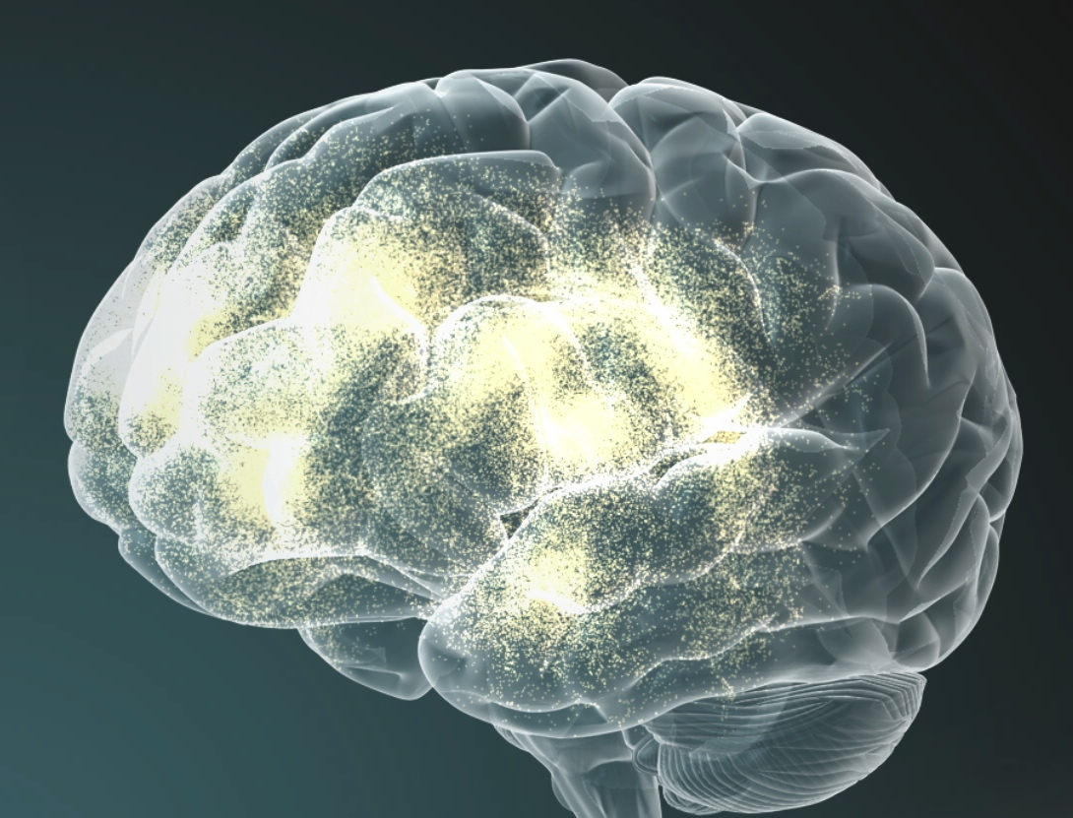
Error
Processing
Behavioral Control
Reaction and Responses
Use of Rules
Working Memory
Risk/Reward Decisions
Emotions
What are the foundational capabilities adults need to be successful parents, workers, and citizens?
What do we know from different sources about how to strengthen those capabilities?
Notes:
What are the foundational capabilities adults need to be successful parents, workers, and citizens?
What do we know from different sources about how to strengthen those capabilities?

Slide 9
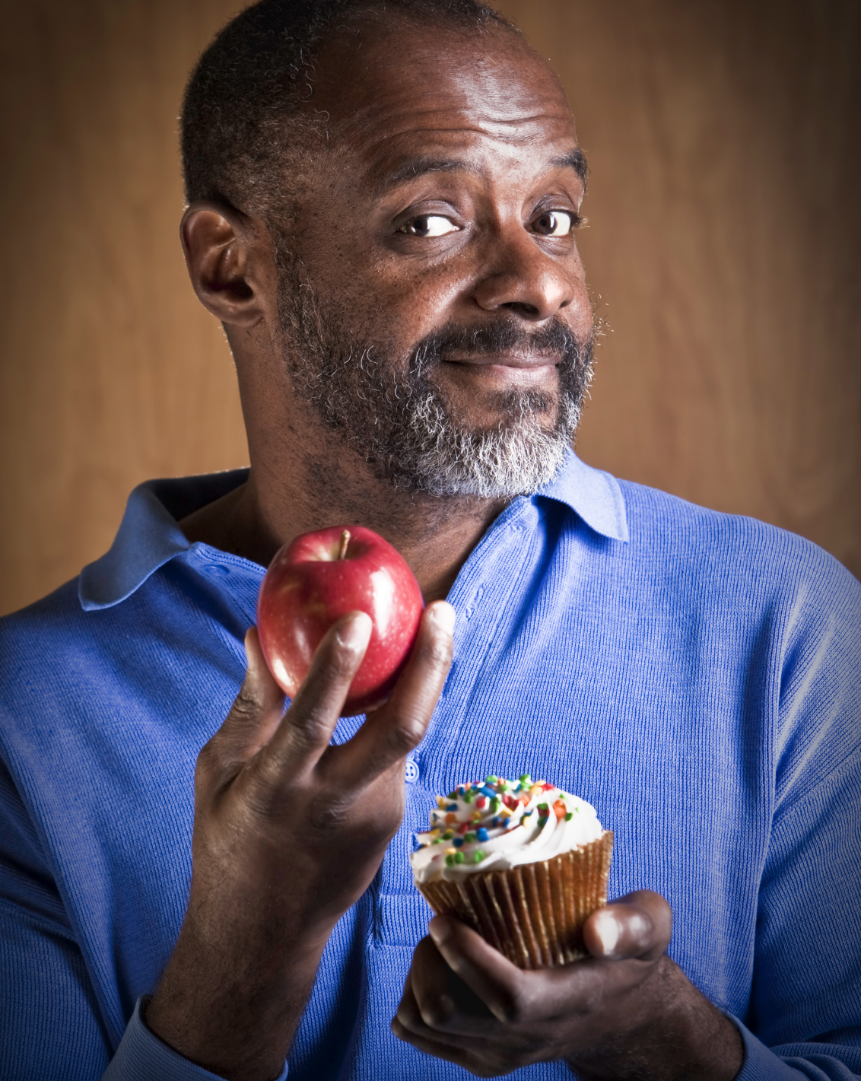
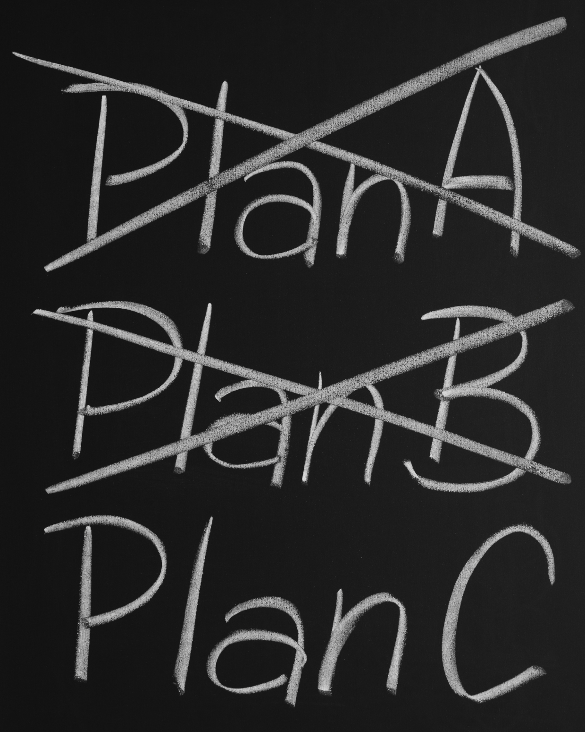
What Do These Skills Look Like in Adults?
Inhibitory Control — filter thoughts and impulses to resist temptations and distractions
Working Memory — hold and manipulate information in our heads over short periods of time
Mental Flexibility — adjust to changed demands, priorities, or perspectives
Notes:
9
What do these skills look like in adults? One particular salient set of skills are grouped together and called Executive Function skills.
This was the focus of last month’s webinar by Silvia Bungue, so I’m just going to quickly recap. Let me acknowledge that if you listened to Silvia’s presentation last month, how I will use a slightly different frame to EF than she did. This is an artifact of how the science translates science.
So we note that there are three key skills, within the group of Executive Function skills
Inhibitory Control…
Working Memory…
Mental Flexibility…
These capacities become the skills:
Remember
Filter
Focus
Plan
Monitor
Adjust
Resist
Persevere
Which leads to outcomes in:
Learning & Work
Follow multi-step instructions
Avoid distractions
Plan & execute
Manage long-term assignments
Adjust to new rules
Seek alternate solutions
Behavior
Teamwork
Leadership
Foresight
Goal-directed
Aware of self & others
Adaptable
Health
Stress Reduction
Nutrition & Exercise
Resist Pressure to Take Risks

Slide 10
Pivot Point
Summary of the science so far
Wouldn’t it be nice if…
New way of approaching the answer
Notes:
Ok, so now, let's recap where we've been:
To sum-up the science:
Early experiences affect lifelong health and learning
Healthy development requires protection and enrichment
Reaching breakthrough outcomes for young children will require building the skills of the adults around them
The foundational capabilities adults need to be successful parents, workers, and citizens include inhibitory control, working memory, and mental flexibility, which are called executive function skills.
So now is the point in the presentation when it would be really nice if I could pivot from here's what the science tells us to, and here's a nice short list of programs that are based on it and that also generate amazing outcomes. I don't have that list.
What I have instead is a new way of approaching how to get to that answer. Our approach is based on the idea that, we need a new way to design, test, and scale new intervention strategies. In short, our fields need a research and development platform. Other fields have them, and it is what keeps them alive. Simultaneously best practice is being taught and implemented, while others are generating new models and creating the better practice of tomorrow. The approach we have been refining and testing with partners across teh country, is what I'm going to share with you next. It is a fast-cycle learning approach that drives science-based innovation with a compelling theory of change and fast-cycle feedback.

Slide 11
Driving Science-Based Innovation with a Compelling Theory of Change and Fast-Cycle Feedback
Continued adaptation
Iterations with larger populations
Breakthrough Outcomes
Pilot,
measure, and adapt
Targeted Scaling
Short Cycle Feedback
Road test intervention
Targeted to local populations and context; Urgency or opportunity
Short Cycle Feedback
Design an Intervention
Short Cycle Feedback
Theory of Change
Scientific Principles
Notes:
Talk thru…
Give an example. This was
Researcher who was interested in building children’s executive function skills, and saw the use of game-playing, particularly board games as a basis for this intervention.
So they partnered with a school. The researcher and practitioners from the school began meeting. They co-created a model to be implemented and they ran the first round of the intervention. They did the road test. As they got the results and they made two important observations:
One children who had strong attention skills at the pre-test were the ones who showed gains in cognitive flexibility at the end. This wasn’t about race or ethnicity or income, but about the skills and capacities the children came to the intervention with, which effected the gains they made.
Second, out of 6 classrooms where it was tried, only one showed tremendous gains. The others didn’t. So the researcher and practitioner team dug deeper into what was happening in that one classroom, and how was that teacher implementing it. What they found was that this teacher had strong classroom management skills, and she had implemented the intervention in a very structured way. And she was scaffolding the children’s skills when they were playing the games, to help them practice taking turns.
So in the next iteration the intervention team incorporated strategies from this teacher’s classroom into the intervention materials and elements.
Attention skills leading to cognitive flexibility
11

Slide 12
Key Elements
Co-creation of the intervention by a researcher-developer, and a practitioner or practice agency
Identification and testing of the explicit mechanisms of the intervention
Attention paid to what works for whom and how so
For the population it works for, scale it
For those not working for, figure out why?
Engagement in a Learning Network
Innovation mind-set. Fail fast. Even non results are good, because they teach us something. Constantly revisit your theory of change.
Notes:
Co-creation with researcher-developer and a practitioner.
So let’s revisit the example we were just talking about. By having the researcher and practitioner working together as a team in the development of the intervention – the team was able to get real-time feedback about how the intervention was going and make fast changes to the intervention. The next chapter of this story is that based on the learning that children’s attention skills at the beginning mattered to what they got out of the intervention. They decided to try adding a mindfulness component. So the idea was to have the children practice mindfulness for 15 minutes a day. The practitioners on the team were able to point out that 15 straight minutes of asking preschoolers to focus on their breathe might be difficult to implement, and found alternative ways to successfully implement the concept into the daily curriculum, in way that was realistic and true to the science.
2. Identify and test the explicit mechanisms of the intervention. We’re going to talk more about this in a minute. We are calling folks to develop very clear theories of change that identify the outcomes at the skills and behavior level you seeking. Articulating what skills and behaviors your intervention are directly going to target. Labeling the casual pathway about what your intervention will do, what it will change, and what outcome that should yield. GIVE EXAMPLES.
3. Pay attention to what works for whom and how so? This to us is also a clear differentiator from business as usual….
For the population it works for, scale it
If not working for some, why?
4. Engage in a Learning network. What we know from innovation science is that you will get to better outcomes faster if you can share your learnings and learn from others. Within the learning network, we recommend going so far as to have a shared database for results, working under aligned theories of change/goals so that you can see if someone else is targeting the same skill or behavior as you. Also using similar measurement tools can facilitate shared learning.
5. Lastly, fail fast. It is completely counter to most of the cultures that each of us operate in every day, but failing and learning from it is a key to getting to innovation. Even non results are good, because they teach us something.

Slide 13
Designing the intervention
What would a researcher and practitioner consider together?
Reflect on for whom current services are working well and for whom could they be working better?
What does the science say that could be relevant to these populations, and the skills and/or behaviors identified?
Consider using human-centered design techniques to “look” with clients about their experience.
See LUMA for more ideas on techniques.
http://www.luma-institute.com
Notes:
So for these next couple slides, we’re going to get more detailed and I’m going to provide some guiding questions and advice for if you’re interested in engaging in this type of process.
What would a researcher and practitioner consider together as they seek to answer what’s the problem we’re going to address?
The site or agency brings knowledge about for whom are current services working well and for whom could they be working better? What skills or behaviors are those who are successful demonstrating, and what skills or behaviors are getting in the way of success?
The researcher-developer brings - what does science say that could be relevant to these populations, and the skills and/or behaviors, identified?
Then a newer technique we’ve been exploring is to adopt human-centered design techniques to “look” with clients about their experience. Human-centered design is a methodology that provides tools to really find out about users experiences, and to harvest insights from that, and to keep the clients, the humans, at the center of the design process. If you’re interested in learning more See LUMA for more ideas on techniques. The website is on the screen.

Slide 14
Designing the intervention
What will your intervention/strategy target?
What are the outcomes that the intervention hopes to impact in adults?
What are the skills and behaviors that the intervention is directly trying to change in adults?
Are there factors that could affect which participants might benefit more from the intervention, and which participants might benefit less or not at all?
Notes:
The next set of questions is about, so what exactly do you want to see change in your clients skills and behaviors to get to better outcomes.
First start by asking: What are the outcomes that you hope to impact in adults? (Give examples)
Then you go backwards and ask, very specifically, if those are the outcomes I want to see then what are the skills and behaviors that the intervention needs to directly try to change in adults? (Give examples) As you can see, these should tie back to the science. Based on what is known from the science, how do I generate the best hypothesis possible about what I need to target that might be getting in the way of my clients success?
Lastly, you want to reflect on, are there factors you think could affect which participants might benefit more from the intervention, and which participants might benefit less or not at all? (Give examples)
Example of FIND
Video coaching model
Outcomes:
father’s involvement in parenting
Parenting stress
Behaviors:
Use of descriptive language
Noticing and accurately interpreting children’s cues
Moderators:
Time father spends with child
Father’s ACES
Intervention fidelity
Document the answers to these. These become your Theory of Change. You will be constantly revisiting them as the process unfolds, as you begin trying out your ideas with real people, getting results in, and learning.

Slide 15
Designing the intervention
3 Key Components of Intervention Development
Theory of Change
Evaluation Plan
Intervention materials
Notes:
Here’s where your researcher-partner takes the lead… valuable but don’t worry so much about the details.
So now you have your theory of change.
The next step is to develop your intervention materials.
Third, is developing your Evaluation Plan. This should tie to the theory of change. And here you’re being intention about ensuring that you are measuring the outcomes that you’re interested in.

Slide 16
Fast-Cycle Learning
Innovation mind-set
Design. Implement. Learn. Adapt. Repeat.
Do a road-test. Does it work in reality like it does in your head? Get feedback from the participants.
Revisit your theory of change. Update based on new information.
Find others to share learnings with. Help to build the field’s usable knowledge.
Notes:
Innovation mind-set. Permission to try things out and do lots of little experiments, before trying to create the thing that you’re going to scale everywhere.
*****
Ok, so, you have your intervention or strategy! Now what? It’s time to start implementing it and fast-cycle learning.
The basic gist here is: Implement. Learn. Adapt. Repeat.
A highly encouraged first step for doing this is. Do a road-test. Does it work in reality like it does in your head? You had a concept of how people would learn things, how quickly they could acquire new skills, whether a group format vs. individual format would work. It is all a working hypothesis in your head, that first should be tested in a low-stakes way. Do a road-test. It can be small – just 5 participants. Get feedback from them. Tweak the materials, tweak the flow of the intervention. Figure out why it worked for some and not others. Generate a learning agenda for yourself during the road-test. Then increase the number of participants.
Revisit your theory of change. Update it based on new information.
Find others to share learnings with. Help to build the usable knowledge.

Slide 17
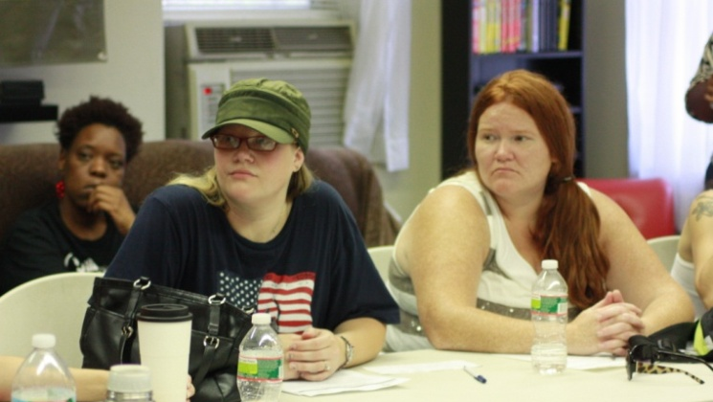
Rapid-Cycle Learning:
The Family Mobility Project
Developing a coaching model focused on shared goal setting with low-income families
Currently co-creating and piloting model with small number of families, incorporating feedback from parents and front-line staff
Notes:
DEPENDING ON TIME – MAY CUT b/c have used enough examples earlier.
So, now I wanted to talk thru a quick example to pull together all the components we’ve been talking about.
Mobility Mentoring is a model some of you might be familiar with. It’s an …..
They had the observation from their experience and wondered if they worked with all of the members of the family, could they accelerate progress for the whole family. It is based on the hypothesis that working in a coordinated way with each family member toward key goals will help the whole family achieve sustainable economic stability and positive developmental outcomes.
So they developed a theory of change about what they were hoping to change in adults and kids (FIND EXAMPLES). They they created materials. If your’e familiar with their model, they have the Bridge to Self-Sufficiency. They drafted a Child Bridge, and a Family Diamond Lane Tool. They decided to road-test it with 5 famlies. They have been doing focus groups with the famileis to see how it’s going. They ask the participants for feedback on the forms and are constantly refining them. Now getting ready to enroll next 10 families. The first 5 haven’t finished, but b/c it’s a longer intervention. They’re thru the first phase.
CONCLUSION
Old notes:
The Family Mobility Project is a joint venture to design and test an innovative, intergenerational strategy to significantly improve the life prospects of young children and families facing the burdens of poverty.
CWU’s model of goal-setting and coaching for women living in poverty. Our aim is to develop, refine, and scale a hybridized intervention strategy that focuses on the common foundational capabilities of successful parenting and economic self-sufficiency by supporting families to set and attain educational, financial, and career-related goals.
The project will begin with a pilot testing phase with a small number of families which will incorporate feedback from both parents and front line staff before proceeding to replication. Using “design-test-iterate” as an accelerated method to develop and scale new interventions, preliminary approaches will be co-developed by a team of key stakeholders (including service providers, content experts, and participating parents), piloted in a real world setting, modified based on experience, and tested again with a larger group.

Slide 18
Summary
Reaching breakthrough outcomes for young children will require building the skills of the adults around them
The foundational capabilities adults need to be successful parents, workers, and citizens include inhibitory control, working memory, and mental flexibility, which are called executive function skills.
Need to create new ideas and interventions informed by the science.
Rapid-cycle learning is a way to generate new ideas and interventions:
Get into an innovation mind-set.
Be very clear about what your intervention will target and how it will work.
Engage in fast-cycle feedback.
Pay attention for whom is the intervention working well and for whom is it not, and why.
Share what you’re learning!
Notes:
So, in sum, what we’ve covered today.
Looking for people who are also constructively dissatisfied with the status quo to work with us on this. Looking for change agents!
18

Slide 19
COREY ZIMMERMAN
Senior Project Manager, Frontiers of Innovation Initiative
Center on the Developing Child at Harvard University
corey_zimmerman@harvard.edu
(617) 495-9041
http://developingchild.harvard.edu/
Notes:
Here’s my contact information. And with that, thank you for your time and I’d like to open it up for questions.

Slide 20
www.buildingbetterprograms.org

